Slide 1
GENITO-URINARY SYSTEM
DISORDERS
M. GICHUKI
Notes:
CHIRA M.W

Slide 2
OBJECTIVES
By the end of the topic the learner will be able to:
Describe the anatomy and physiology of the genito-urinary system
Describe various tests and examination performed to diagnose genito-urinary system disorders
Describe common renal function tests
Describe common urinary disorders including kidney disorders, ureters, urinary bladder, urethra, prostate gland and the scrotum.
Describe the following conditions under the topics under the headings; definition, causes, clinical features, diagnosis and management

Slide 3
.
Kidney conditions:
Pyelonephritis, Glomerulonephritis, Nephritic syndrome, Polycystic kidney disease, Renal failure, Haemodialysis, Peritoneal dialysis, Tuberculosis of the kidney, Renal calculi, Renal trauma, Renal tumours
Kidney transplantation: Indication, Pre-operative care, Post-operative care
Conditions of the ureter : Hydro nephrosis
Fistulae:
Conditions of the urinary bladder:
Neurogenic bladder
Diverticula
Inflammation
Tumours

Slide 4
.
Male reproductive tract conditions
Infections of the male reproductive tract i.e. epididymitis, orchitis, prostatitis
Tumors i.e. benign prostatic hyperplasia, cancer of the prostate, testicular cancer.
Other male reproductive conditions i.e.
Phimosis, priapism, testicular torsion, balanitis, varicocele, hydrocele
Conditions of the urethra:
  Hypospadias
  Epispadias
  Urethritis
  Urethral stricture
  Conditions of the scrotum

Slide 5
GROUP ASSIGNMENTS
Hydronephrosis
Fistulae
Diverticuli
TB Kidney
Renal trauma

Slide 6
REVIEW OF ANATOMY AND PHYSIOLOGY
The urinary system is composed of the kidneys, ureters, bladder and urethra.
The kidneys are located retro-peritoneally from T12 to L3. The are surrounded by a fibrous capsule.
Right kidney is lower than left. Each adult kidney weighs about 120-170g
Kidney has 2 distinct parts: a) renal parenchyma
b) renal pelvis
Renal parenchyma consists of : outer cortex and an inner medulla. Renal medulla resembles conical pyramids
Blood supply is from the renal artery, a branch of the abdominal aorta.
Kidneys are drained by the renal vein into the inferior vena cava.

Slide 7
.
The basic functional unit of the kidney is the nephron. There are approximately one million in each kidney
Nephron consists of a glomerulus which has tufts of capillaries supplied with blood by the afferent arteriole and drained by the efferent arteriole.
The glomerulus at the base forms a tubule that is divided into 3parts:
a) proximal convoluted tubule,
b) loop of henle
c) distal convoluted tubule.

Slide 8
.
The distal tubules join to form collecting ducts approx. 20mm long.
The ducts connect to the renal pyramids (8-18 pyramids), the pyramids drain into minor calyces(4-13) which drain into(2-3) major calyces that open into the renal pelvis.
Each renal pelvis gives rise to a ureter which is approx 25 cm. It connects each kidney to the urinary bladder.

Slide 9
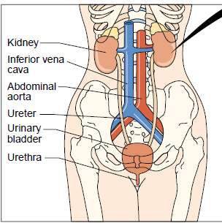
.

Slide 10
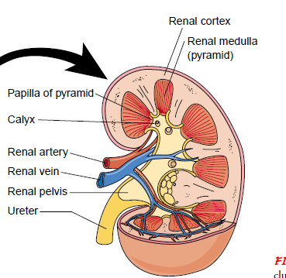
.

Slide 11
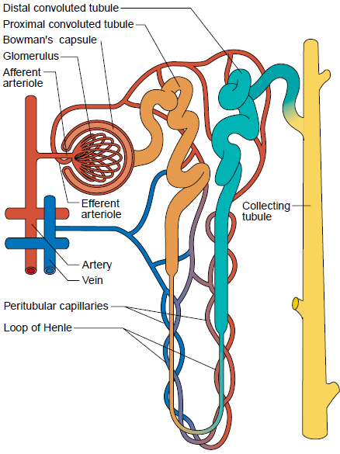
.

Slide 12
.
There 3 filtering layers of the glomerulus
-Capillary endothelium
-The basement membrane
-The epithelium of the glomerulus
It prevents filtering of blood cells and plasma proteins
The filtered fluid undergoes selective re-absorption to form the urine
Glomerular filtration rate ==== 125mls/min

Slide 13
.
Ureters has three narrowed areas (angled areas) : -ureteralpelvic junction
-ureteral segment near the sacroiliac joint
-Ureteral vesicle junction
The angles prevent vesicles ureteral reflux (back flow of urine from the bladder to the ureters towards kidney
When the bladder is full, the ureteral vesicle juction remains closed
The 3 areas of narrowing are prone to obstruction by kidney stones or stricture

Slide 14
.
Urinary bladder is located just behind the pubic bone. It is the reservoir of urine
Adult bladder can hold between 300mls – 600mls of urine.
One feels the strong desire to void when the bladder has 350mls or more of urine (functional capacity)
During anaesthesia, a bladder can hold 1500mls to 2000mls (anatomic capacity)
Has 2 inlets (ureters) and 1 outlet urethrovesiscle junction
The innermost layer of the bladder (urothelium) is impermiable to water and prevent ‘reabsorption’ of the urine

Slide 15
.
Bladder neck contains involuntary smooth muscles that forms part of the urethral sphincter called the internal sphincter
The external sphincter is voluntary
Urethra in males passes through the penis and is surrounded by the prostate gland posteriorly and laterally below the bladder neck
In female it opens just anterior to the vagina

Slide 16
Functions of the kidney
a. Formation of urine: formed by three steps
-glomerular filtration,
-tubular re-absorption and
-tubular secretion
-Each day 1000-1500mls of urine is excreted
-Re-absorption and secretion involves passive and active movement

Slide 17
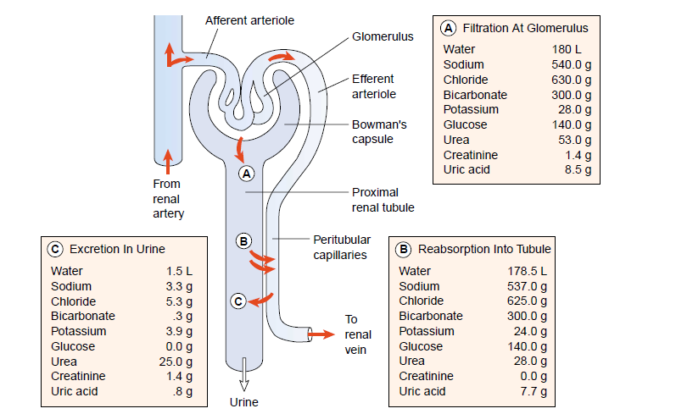
.

Slide 18
.
b. Excretion of waste products: eg urea, creatinine, phosphates, sulphates, uric acid, drug metabolites
c. Regulation of acid-base balance through reabsorption of bicarbonate ions, buffering with ammonia (NH3) and phosphate and direct secretion into urine.
d. Regulation of electrolytes. Through hormones like aldosterone. Increased aldosterone secretion reduces the amount of sodium excreted and increases the amount of potassium excreted.
e. Regulation of blood pressure through the renin-angiotensin-aldosterone system (RAAS)

Slide 19
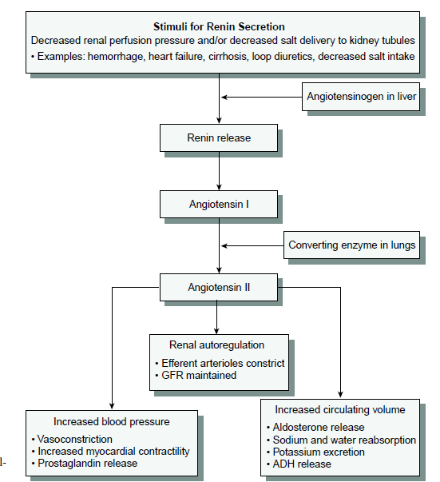
.

Slide 20
.
f. Regulation of RBC production through the hormone erythropoietin.
g. Regulation of water excretion through the effects of antidiuretic hormone (ADH) from posterior pituitary. Also called vasopressin
h. Synthesis of Vit D. it is converted to its active form, 1,25 dihydroxycholecalciferol. Necessary form calcium balance in the body
i. Secretion of prostagladin E ( PGE) and prostacyclin. They are vasodilators and maintain normal renal blood flow.
Normal renal blood flow----1200mls per min
(20-25% of CARDIAC OUTPUT)
Notes:
CHIRA M.W

Slide 21
Describe the process of urine formation and the composition of urine

Slide 22
ASSESSMENT OF RENAL SYSTEM
Health History:
The chief complaints, onset of the symptom, effects on quality of life
History of presenting complaints
  Pain- character, duration and location (usually in the lumbar region). Factors precipitating pain and relieving factors
  Voiding patterns- frequency, Hesistancy, dribbling, amount, color etc
  Dysuria (pain when urinating) when it occurs at termination or initiation
  Urinary incontinence..stress incontinence, urge incontinence, overflow incontinence.
  Hematuria, blood in urine
  Nocturia..urinating at night

Slide 23
.
Past medical history-
history of diabetes, hypertension, gout,
  History of STI or UTI and treatment.
  History of manipulation of the urinary tract through diagnostic means e.g. catheterization
  Fevers, chills hx
  Gynaecological hx: Female patients: number and type of deliveries. Use of family planning and the method
  Family social history. Family members with renal disease, diabetes, hypertension
  Habits: smoking, alcohols, drugs, over the counter drugs

Slide 24
Common location of genitourinary pain.
Kidney---costovertebral angle (CVA). May extend to the umbilicus. Positive murphy’s punch sign
Bladder– suprapubic area. Severe when bladder is full
Ureteral – costovertebral angle, lower abdominal area, testis or labia
Prostatic –perineum and rectum
Urethral- male- along penis to meatus
Female- urethra to meatus

Slide 25
Changes in voiding
Frequncy: frequent voiding more than every 3 hours
Urgency: strong desire to void
Dysuria: painful or difficulty in voiding
Hesistacy: difficulty initiating voiding
Nocturia : excessive urinating at night
Incontinence: involuntary urination
Enuresis: involuntary voiding during sleep
Polyuria: voiding large volume of urine
Oliguria: urine output less than 400mls/day
Anuria: urine output less than 50mls/day
Hematuria: RBCs in the urine
Proteinuria: abnormal amounts of proteins in the urine

Slide 26
Physical assessment.
Inspection:
Head to toe. Detect changes e g puffiness, pallor due to anaemia.
Edema due to accumulation of fluid.
skin excoriation due to uremic crystals
Assess changes in body weight – weight increases due to edema water retention.

Slide 27
.
Auscultation
Lung sounds to rule out pulmonary edema secondary to fluid retention.
Renal artery bruits-above and to the left of the umbilicus
PERCUSSION:
Bladder for fullness. Empty bladder is tympanic while full bladder gives off a dull sound.
percuss abdomen to rule out ascites (shifting dullness)
Percuss the costovertebral angle. This produces pain in case of renal dysfunction ( positive murphy’s sign)

Slide 28
.
PALPATION:
The flanks for any palpable mass.
The kidneys are not normally palpable, though the smooth, round lower pole of the kidney especially the right may be palpated since its lower
Kidney dysfunction may produce pain and tenderness at the costovertebral angle

Slide 29
Diagnostic evaluation
Urine Exam
1. Volume: Increase means increase in protein catabolism and renal disorders e.g diabetes inspidus and glycosuria
Terms for volume:- Oliguria, anuria,

Slide 30

Color: Normal straw color or pale yellow to gold.

Slide 31
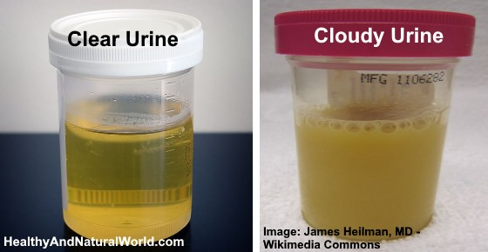
Smell:- Urine smells, but should not be noticeable. Abnormal????
Appearance:- Clear. Turbid in some conditions candidiasis, mucous from vagina, blood cells, crystals,

Slide 32
URINALYSIS, CULTURE, MICROSCOPY
Specific gravity:-Measure of dissolved solutes. Low in Diabetes Inspidus and high in DM, Acute Renal Failure and excess medications
Osmolarity:- Decreases in D. Inspidus. Most accurate measure of the kidneys’ ability to concentrate urine. This shows the concentrating ability of the kidneys
pH: Measure of H⁺ concentration. Depends on diet. Normal is 7.3 to 7.8. Decreases in renal diseases and non-vegetarian diet, high in vegetarians.

Slide 33
Urine culture determines whether bacteria are present in urine, their strains and concentration.
Urine culture & sensitivity also identifies the antimicrobial best suited.
Urine is examined for:-
  Hematuria (RBCs in urine), white boold cells, pus (pyuria) and bacteria (bacteriuria)
  Presence of glucose(glucosuria),proteins(proteinuria) and ketone bodies(ketonuria)

Slide 34
.
RENAL FUNCTION TESTS:
They are used to evaluate the severity of kidney disease and assess the status of the patients kidney function. They include:
Renal concentration tests
specific gravity: measurement of kidneys ability to concentrate urine. It compares weight of urine and that of distilled water which is 1.000
-Normal specific gravity range for urine is
1.010 to 1.025

Slide 35
.
It depends on hydration status of the individual
When fluid intake reduces, specific gravity increases and the vice versa is true.
Causes of low specific gravity of urine includes: diabetes inspidus,
glomerulonephritis,
severe renal damage
Causes of increased specific gravity includes: diabetes melitus,
nephrosis and
excessive fluid loss.

Slide 36
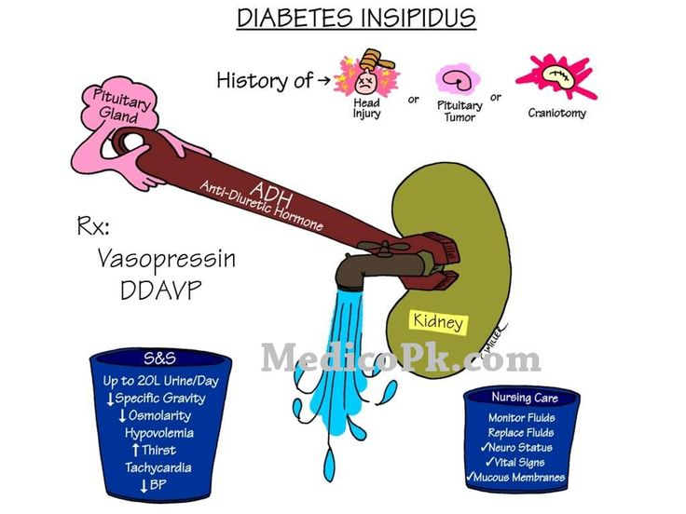
.

Slide 37
.
OSMOLARITY:
The measurement of the number of particles (electrolytes) dissolved in a kilogram of urine
Normal values is between 50-1200 mOsmol/kg
SERUM TESTS
Creatinine level : end product of muscle energy metabolism. The test measures the effectiveness of renal function. Creatinine is not reabsorbed in the nephrone. Normal serum levels 50-110 µmol/litre.
1mg/dl of creatinine = 88.4µmol/l
Serum creatinine levels more than 110 can indicate severe renal disease
Blood urea nitrogen (BUN): serves as an index of renal function. urea is a product of protein metabolism. Normal serum value 7-18mg/dl
The normal ration of BUN and creatinine is 10: 1 this may increase in hypovolumia

Slide 38
.
Uric acid normal range is 2.5-5.5mg/dl for women and 4.5-6.5mg/dl for men
Sodium normal range is 135-145mEq/l
Potassium normal range is 3.5-5.5mEq/l
Calcium normal range is 9-11mg/dl
Phosphorus normal range is 2.8-4.5 mg/dl
Bicarbonate normal range 20-30mEq/l. Most patients in renal failure have metabolic acidosis and low serum HCO3- levels

Slide 39
Radiological studies
X-ray of the KUB (kidney, ureter, bladder studies) show size, shape, position of kidneys.
Reveals abnormalities like calculi (stones), hydronephrosis (distension of renal pelvis), cysts, tumors,
Renal ultrasonography- (done on full bladder)
CT (computed tomography) scan and magnetic resonance imaging MRI

Slide 40
.
Retrograde pyelogram-catheters are advanced through the ureters into the renal pelvis by cystoscopy. A contrast agent is then injected.
Cystography- a catheter is inserted into the bladder and contrast agent is injected. It evaluates vesicoureteral reflux (backflow of urine into ureters).
Renal angiography/arteriography- provides an image of the renal arteries. A catheter is inserted to the renal arteries to evaluate renal blood flow

Slide 41
.
Bladder ultrasonography: it measures the urine volume in the bladder
Intravenous urography: a dye is injected intravenously and images taken via X-ray as the die moves through upper and then lower urinary system
Cystoscopy: a cystoscope is inserted through the urethra to directly visualise bladder and the urethra, openings of the ureter, and the prostatic urethra as in the diagram below

Slide 42
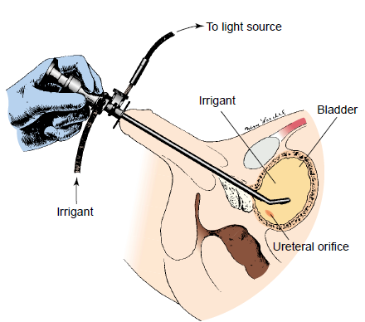
.

Slide 43
BIOPSY
Ureteral biopsy, kidney biopsy may be taken and evaluated to give more information
Can be used to differentiate btw tumor, kidney stone, blood clot
May be indicated incase of transplant rejection, glomerulopathies, unexplained renal failure and persistent proteinuria or hematuria.

Slide 44
Nursing diagnosis for patients undergoing renal tests
Knowledge deficit about the procedure and the test
Fear/anxiety related to possible diagnosis of serious illness, altered renal function and embarrassment discussing the urinary function and exposure of genitalia

Slide 45
INFECTIONS OF URINARY TRACT
Lower urinary tract infection:
bacterial cystitis—inflammation of bladder
bacterial prostitis- inflammation of prostate gland
bacterial urethritis- inflammation of urethra
Upper urinary tract infection includes:
-Pyelonephritis (acute or chronic)-inflammation of renal pelvis
-Ureteritis
-Interstitial nephritis: inflammation of the kidney
The most common micro-organism causing UTI is Escherichia coli

Slide 46
Bacteriuria is defined as more than 10⁵ colonies of bacteria per millilitre of urine. Urinary tract is the second most common site of infection
Classification(Cont)
According to other patient-related conditions e.g recurrence, duration of the infection
Uncomplicated Lower or Upper UTI
  Community-acquired infection; common in young women
Complicated Lower or Upper UTI
  nosocomial (hospital-acquired) and related to catheterization
  urologic abnormalities, pregnancy,
  immunosuppressant, diabetes mellitus, obstructions

Slide 47
Risk factors for developing UTIs
Inability to completely empty the bladder
Obstruction of urinary flow e.g. due to tumors, calculi, congenital anomalies
Immunosuppression
Instrumentation e.g. catheters, cystoscopy
Inflammation of the urethral mucosa
Presence of other conditions e.g. DM, pregnancy, gout, neurologic disorders.
Gender: common in female due to anatomic relation to the anus, short urethra

Slide 48
PYELONEPHRITIS
It is a bacteria infection of the one or both kidneys.
Involves:
    renal pelvis,
    tubules
    interstitial tissues.
Bacteria reach the kidney from the bladder
ureterovesicle reflux (ascending infection) or
bloodstream [hematogenous ( rare..< 3%)

Slide 49
.
Mostly caused by Escherichia coli that ascends the urinary tract. Others causes are Kleibsiella sp. & Proteus sp., staph aureus, and streptococcus faecalis
It is more common in females than in males because:-
  The female urethra is short
  Close proximity of the urethral opening to the anus
  Pregnancy-due to kinking of ureters causing stasis and reflux of urine

Slide 50
.
Risk factors:
  Catheterization ,cystoscopy and other procedures involving use of urinay tract diagnostic and therapeutic instruments
  Inability to empty the bladder as in Neurogenic bladder,urine stasis,Urinary tract obstruction, BPH,bladder tumors, strictures, kidney stones,
  Other conditions ;Pregnancy, Ureterovesicle reflux,diabetes mellitus

Slide 51
PYELONEPHRITIS
There are two types of pyelonephritis viz;
  Acute: Sudden onset
  Chronic: from recurrent acute infections

Slide 52
.
  ACUTE PYELONEPHRITIS
Pathophysiology
Bacteria gains access through urethra to the kidney…or through blood& lymph
Pyelonephritis is due to uretero-vesicle reflux of urine..or stasis of urine due to obstruction in ureters.
The bacteria initiates inflammation. Cell destruction from trauma to the renal pelvis initiates an inflammatory reaction.
Interstitial inflammation may lead to destruction of tubules and glomeruli

Slide 53
.
Signs and symptoms
  Urinary urgency and frequency
  Burning sensation during micturition,
  Cloudy urine,ammoniacal or fish odor
  Chills, fever high temp ≥38.9⁰c
  Dysuria, hematuria
  Flank pain, CVA tenderness (costovertebral angle)
  Anorexia, fatigue

Slide 54
.
Pain and tenderness in the area of the costovertebral angles-(CVA), which are the angles formed on each side of the body by the bottom rib of the rib cage and the vertebral column
+ve Murphy’s Punch sign ( costalvertebral angle tenderness

Slide 55
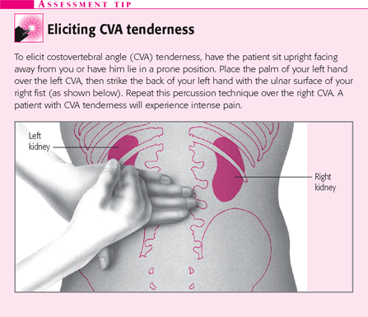
.

Slide 56
.
Diagnostics tests
  Urinalysis- to check for pyuria, presence of RBCs, Low specific gravity, Slightly alkaline, glucosuria,
  Culture –presence of the organisms
  Ultrasound or a CT scan -locate any obstruction in the urinary tract.

Slide 57
Management
Pharmacotherapy
If patient is not dehydrated and has no signs of sepsis, manage as an outpatient.
Pregnant women may be hospitalized for 2-3 days for parenteral antibiotic therapy and changed to oral once there is improvement.
In out patient, antibiotics are given for two weeks, mostly quinolones e.g. ciprofloxacin 100-500mg BD, nitrofurantoin 50-100mg QID, 3 rd generation cephalosporins e.g. ceftriaxone or penicillins e.g. ampicillin.

Slide 58
.
A follow up urine culture is obtained two weeks after completion of antibiotics.
Give plenty of fluids to ‘flush’ the urinary tract.
Analgesics for pain. Paracetamol 1 gm tds

Slide 59
Nursing management
Assessment: hydration status, nutritional status, voiding pattern, vital signs, pain.
Nursing diagnosis
  Altered comfort related to Fever, pain
  Risk for fluid volume deficit and electrolytes imbalance related to excessive urination...
  Altered patterns of urinary elimination
  risk for re-infection
  Risk for altered nutrition less than body requirements related to appetite loss
  Self care deficit

Slide 60
.
Implementation
Administration of antibiotics, analgesics, antipyretics
Position patient
Urinalysis to identify the renal function
Assess to identify the area of pain
Fluid in put /output chart maintanance
Psychosocial support
Education on:Treatment adherence, Hygeine, fluid intake and voiding habits
Encourage Bed rest

Slide 61
.
Complications of acute pyelonephritis
Chronic Pyelonephritis
Renal Failure
Septicaemia

Slide 62
.
CHRONIC PYELONEPHRITIS
Definition:persistent inflammation (due to repeated acute pyelonephritis) and scarring of the kidneys with deformation of the renal calyces.
Signs and symptoms
Usually has no signs unless an acute exacerbation occurs
History of recurrent infections
Low urine specific gravity
Hypertension
Proteinuria
Leucocytes in urine
Other noticeable signs:Fatigue, Headache, Poor appetite, Polyuria, Excessive thirst, Weight loss
Imaging techniques indicate deformations such as a small renal pelvis-

Slide 63
.
Assessment & diagnostic investigations
Creatinine clearance and serum levels
BUN
Urine for culture and sensitivity
IV urography to assess extent of disease
MANAGEMENT
Antibiotics based on culture and sensitivity
Nitrofurantoin is used to supress bacterial growth 50-100mg QID 1 week.

Slide 64
.
Interventions
Give antibiotic medication, anti inflammatory drugs and antipyretics
Give a balanced diet, small frequent meals and monitor weight.
Monitor urine output through a strict input- output chart. Give plenty of fluids(3-4 litres per day) to reduce the burning sensation and prevent deH2O
Health education on drug compliance and hygiene( perineal), importance of plenty of fluids, regular bladder emptying.
Monitor temp every 4 hrs.

Slide 65
.
COMPLICATIONS
End stage renal disease
Hypertension
Kidney stones

Slide 66
LOWER
URINARY TRACT INFECTIONS
CYSTITIS
It is inflammation of the bladder from any cause, but most often is secondary to bacterial infection.
More common in women than men ….why?
Causes
Escherichia coli 80-90% of cases
Others…Pseudomonas aeruginosa Klebsiella, Pseudomonas, group B Streptococci, Proteus,Chlamydia trachomatis,

Slide 67
.
Signs & symptoms
Pain/ burning sensation on urination- dysuria
Frequency- more than once every three hours
Urgency
Feeling of incomplete voiding
Cloudy urine
Hematuria
Lower abdominal pain (suprapubic pain)
Fever and chills
Fatigue, nausea and vomiting

Slide 68
.
Pathophysiology
Bacteria gain access to the bladder,
Bacteria attach to and colonize the epithelium of the urinary tract to avoid being washed out with voiding, evade host defense mechanisms,
Bacteria initiate inflammation.
Effects.. Edema, small hemorrhage…hematuria
Most UTIs result from fecal organisms that ascend from the perineum to the urethra and the bladder and then adhere to the mucosal surfaces

Slide 69
.
Routes by which bacteria enter the urinary tract:
Up the urethra (ascending infection),
Through the bloodstream, (hematogenous spread),
By means of a fistula from the intestine (direct extension)

Slide 70
.
Laboratory tests
Mid –stream specimen of urine for;
microscopy → WBCs ,RBCs, pus
Urine culture or gram stain-definitive
Bacteriuria- more than 100,000 colonies of bacteria per milliliter of urine confirms diagnosis
Urinalysis
Dipstick → blood, protein, nitrites
Blood glucose: if suggestive of Diabetes Mellitus

Slide 71
.
Goals of Management
Relieve symptoms
Prevent ascending infection
Eradicate bacteria from the bladder

Slide 72
.
Antibiotics for 5-10days;10-14 days
  Penicillins-amoxycillin,
  Sulphonamides- sulfamethoxazole/trimethoprim
  Nitrofurantion 50-100mg bd for 7 days
  Fluoroquinolones eg ciprofloxacin 100-500mg bd for 3/7
  Nalidixic acid 500mg- 1g QID for 1 week
  If chronic, cefadroxil (1st generation cephalosporin) 500mg-1g BD for 5 days
Analgesics & antipyretics

Slide 73
.
Nursing care
Monitor temperature four hourly
Encourage in take of plenty of water and other fluids
Encourage client to empty his/her bladder as soon as urge is felt
Educate on strict perineal hygiene
POTENTIAL COMPLICATIONS
Ascending infection→ pyelonephritis
Chronic cystitis

Slide 74
URETHRITIS
Definition
Inflammation of the urethra
Urethritis is an inflammatory condition that can be infectious or post-traumatic.

Slide 75
Causes
Infective causes of urethritis are typically sexually transmitted and categorized as :
  Gonococcal urethritis (GCU)- infections of Neisseria gonorrhoeae
  Nongonococcal urethritis (NGU)-infection with Chlamydia trachomatis, Trichomonas vaginalis, Mycoplasma genitalium
In men inflammation causes burning sensation at the orifice
A discharge occurs, 3-14 days after sexual exposure

Slide 76
History
H/O of Urethral discharge, dysuria, and exposure to a partner with STD
Approx.25% of those with NGU, are asymptomatic and present following partner screening.
But clients may experience the following symptoms:
  Urethral discharge, purulent or mucopurulent
  Dysuria
  Urethral pruritus (itchy urethra)
NB:
Urinary frequency & urgency are absent. If present, should suggest prostatitis or cystitis.
Systemic symptoms (eg, fever, chills, sweats, nausea) are typically absent but, if present, may suggest disseminated gonococcemia, pyelonephritis, orchitis, or other infection.

Slide 77
Non- gonococcal ( Chlamydia, Trichomonas)
In men there is mild to severe dysuria and scanty discharge
Female are asymptomatic until there is development of PID (pelvic inflammatory disease)
NB: chlamydia is sensitive to tetracycline e.g doxycycline.

Slide 78
Preventing future urinary tract infections
Drink plenty of water every day.
Large amounts of vitamin C inhibit the growth of some bacteria by acidifying the urine.
Encourage frequent urination as appropriate
Wipe from front to back to prevent bacteria around the anus from entering the vagina or urethra.
Take showers instead of tub baths.
Cleanse the genital area before/after sexual intercourse.
Hygiene during menstrual flows

Slide 79
GLOMERULONEPHRITIS
Definition:
inflammation of the renal glomeruli of both kidneys resulting from immunologic processes.
Can be acute or chronic, depending on the onset

Slide 80
Acute GlomeruloNephritis
Definition: Bilateral inflammation of the glomeruli, of sudden on-set, which usually follows streptococcal infection of the respiratory tract (throat) or skin infection such as impetigo
Cause
The most common - Reaction to Group A beta-hemolytic streptococcal infection e.g. Streptococcus pyogenes
BUT
Other specific agents include viruses and parasites, systemic and renal disease, visceral abscesses, endocarditis, infected grafts or shunts and pneumonia.
In some patients, antigens outside the body e.g. drugs, foreign serum, may initiate the process.

Slide 81
Pathophysiology
Antigen –antibodies complexes are produced in response to streptococcal infection
They are deposited in the glomerular capillary membranes which activates the inflammatory response
Lysosomes are released during the inflammatory response. They damage the glomerular basement membrane
Proliferation of glomerular cells then occurs.
Leucocytes infiltrate in the glomerulus causing swelling and thickening of the glomerular membrane

Slide 82
This damages of the glomeruli causing permeability of glomerular membrane which result in:
loss of selective permeability
Decrease in the functional surface area
Reduced GFR
Increased filtration of RBCs & protein molecules to urine

Slide 83
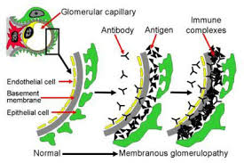
.

Slide 84
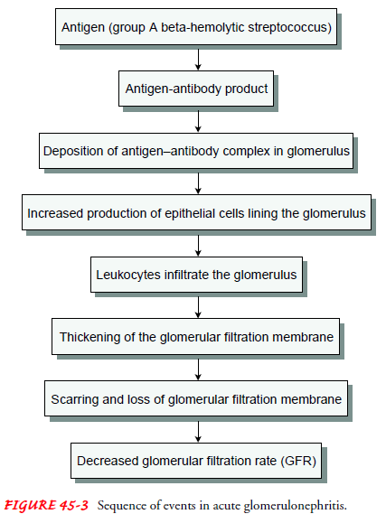
.

Slide 85
.
Clinical Manifestations
A sudden onset of headache, puffiness of the eyelids , facial edema.
History of a recent (1-2 wks) respiratory or skin infection (2-4 wks)
Hypertension due to reduced GFR, Fluid retention and altered renal regulation of blood pressure
Edema due to Loss of intravascular oncotic pressure
Nonspecific symptoms include weakness, fever, flank pain (CVA), and malaise

Slide 86
Oliguria or anuria
Azotemia (increased urea concentration in blood) due to impaired filtration of nitrogenous wastes.
Hematuria due to Loss of capillary wall integrity...primary presenting feature
Proteinuria due to Altered permeability of capillary walls
Increased Specific gravity
Urine appear cola colored due to RBCs casts
Increased antibody titers to other antigens, such as antistreptolysin O

Slide 87
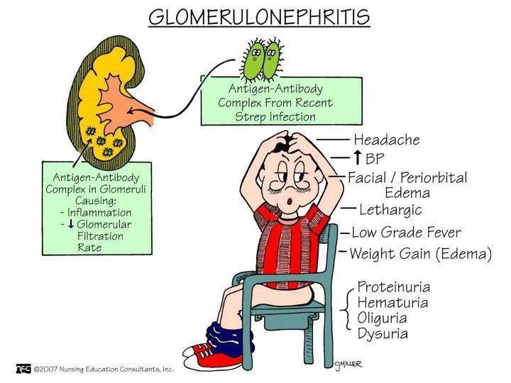
.

Slide 88
Diagnostic tests
Lab. Studies
  ↑Antistreptolysin O (ASO) titer in 60-80% of patients, post-streptococcal infection
  ↑Erythrocyte sedimentation rate (ESR)
  Urine or plasma creatinine level
  Cultures of throat and skin lesions to rule out Streptococcus species may be obtained
Comprehensive physical examination
Lab. Studies
  Urinalysis
  Dark urine.
  Specific gravity is> 1.020
  Proteinuria
  RBCs and red cell casts
  a 24-hour urine protein excretion and creatinine clearance for the degree of renal dysfunction and proteinuria.

Slide 89
Imaging Studies
KUB X-Ray(Kidney,Ureters &bladder) show bilateral kidney enlargement
In glomerulonephritis..kidney becomes swollen, large and congested
Bedside renal ultrasonography to evaluate kidney size & determine the extent of fibrosis.
A renal biopsy –renal tissue status

Slide 90
Management
Goals :
  Relief of symptoms
  Prevention of complications
  Reverse kidney function
  Prevention of progression of renal disease

Slide 91
.
Pharmacotherapy
Antibiotics-Penicillins ( antibiotic of choice) to treat streptococcus infection
Antihypertensives & Diuretics to control BP and fluid volume
Corticosteroids and immunosuppressant (Prednisone) may be used.
Diet modification
reduce protein, sodium and potassium intake
increase Carbohydrates & Vitamins
Monitor fluid in put & out put
Correction of electrolyte abnormalities (hypocalcemia, hyperkalemia) and acidosis as appropriate

Slide 92
Complications of AGN
Metabolic acidosis
Chronic renal failure
Hypertensive encephalopathy
Hypertensive retinopathy
Chronic Glomerulonephritis
Heart failure
Pulmonary edema

Slide 93
Chronic Glomerulonephritis
Def: A syndrome that reflects end stage of glomerular inflammatory disease. It develops and progresses over many years.
May result from repeated episodes of acute GN
The onset is gradual
Glomerular inflammatory disease with atrophy of the glomerulus
Characterized by proteinuria, haematuria and slow development of uremic syndrome
It is always detected coincidentally when investigating the cause of Hypertension and abnormalities in urine

Slide 94
Causes:
Repeated episodes of;
acute glomerulonephritis,
hypertensive nephrosclerosis,
hyperlipidemia,
chronic tubulointerstitial injury
hemodynamically mediated glomerular sclerosis.

Slide 95
.
Pathophysiology:
The kidneys are reduced to:
  1/5th their normal size (consisting largely of fibrous tissue).
  The cortex shrinks to a layer 1 to 2 mm thick or less.
  Bands of scar tissue distort the remaining cortex, making the surface of the kidney rough and irregular.
  Numerous glomeruli and their tubules become scarred
  Thickening of the branches of the renal artery
  Severe glomerular damage that results in ESRD (End stage Renal disease).

Slide 96
Clinical features
Varied including:
  severe disease may have no symptoms for many years.
  Discovery with hypertension or elevated BUN and serum creatinine levels are detected.
  During a routine eye examination when vascular changes or retinal hemorrhages are found.
  sudden, severe nosebleed, a stroke or seizure
  Signs And Symptoms of Heart Failure May Be Present.
  Signs Of Neurologic And Pulmonary Complications

Slide 97
.
Some pts-feet are slightly swollen at night.
Most patients also have general symptoms, such as:
  loss of weight and strength
  increasing irritability
  an increased need to urinate at night (nocturia).
  Headaches, dizziness and digestive disturbances

Slide 98
.
Signs and symptoms of renal insufficiency and chronic renal failure may develop.
Poor nourishment with yellow-gray pigmentation of the skin
Periorbital and peripheral (dependent)edema.
Blood pressure may be normal or severely elevated.
Retinal hemorrhage,
Anaemia

Slide 99
.
Diagnostics tests include;
Urinalysis
Ultrasound and CT scan
Chest x-rays - cardiac enlargement and pulmonary edema
ECG-cardiac changes with signs of electrolyte disturbances…tall T wave associated with hyperkalemia
Renal biopsy identifies the cause and nature of GN

Slide 100
.
Assessment and Diagnostic Findings
Urinalysis
    fixed specific gravity of about 1.010
    variable proteinuria
    Urinary casts (protein plugs secreted by damaged kidney tubules).
Changes occurring with progressing renal failure and GFR falls below 50 ml/min :
Hyperkalemia due to
    decreased potassium excretion, acidosis, catabolism excessive potassium intake from food and medications

Slide 101
.
Metabolic acidosis due to
    decreased acid secretion by the kidney
    and inability to regenerate bicarbonate
Anemia secondary to decreased erythropoiesis
Hypoalbuminemia with edema
    secondary to protein loss through the damaged glomerular membrane
Increased serum phosphorus level due to decreased renal excretion of phosphorus

Slide 102
Hypocalcaemia- to compensate for elevated serum phosphorus levels
Hypermagnesemia from decreased excretion and ingestion of antacids containing magnesium
Impaired nerve conduction due to electrolyte abnormalities and uremia

Slide 103
Management
Guided by the symptoms.
Hypertensive patient- monitor BP, give antihypertensives, sodium and water restriction.

Slide 104
.
Circulatory congestion and pulmonary edema
  restrict sodium and fluid
  Diuretics –furosemide
    Avoid potassium-sparing diuretics due to increased risk of hyperkalemia.
  Manage the airway based upon the degree of pulmonary congestion and respiratory distress.
  Dialysis
  Digitalis is NOT effective.
  Preload and afterload reductions are indicated for hypertensive pulmonary edema (eg, nitrates, morphine, diuretics)

Slide 105
.
Monitor weight daily
Provide Proteins of high biologic value (dairy products, eggs, meats) to promote good nutritional status
Adequate calories -to spare protein for tissue growth and repair.
Treat UTIs promptly to prevent further renal damage

Slide 106
Nursing management
Assessment
Nursing diagnosis
  Altered tissue perfusion related to elevated blood pressure & accumulation of fluid in the interstitial tissues
  Excess fluid volume related to plasma protein deficit and sodium and water retention evidence by....edema
  Risk for secondary infection related to alteration on body immune system secondary to use of immunosuppressants and antiinflammatory drugs
  Imbalanced nutritrition; less than body requirements related to decreased ability of the glomerular membrane to prevent protein filtration ,diminished appetite and increased catabolism secondary to inflammatory processes
  Pain related to inflammatory processes in the kidneys

Slide 107
.
Expected Outcomes
The patient will:
Maintain blood pressure within normal limits.
Return to usual weight with no evidence of edema.
Consume adequate calories following prescribed dietary limitations.
Verbalize reduced anxiety
Demonstrate an understanding of acute glomerulonephritis and prescribed treatment regimen.

Slide 108
.
Planning & interventions
Observe Vital signs every 4 hours .
Provide complete bed rest
Weigh daily
Perform urinalysis every day-haematuria & proteinuria
Restrict & Balance intake and output every 8 hours.
Arrange dietary consultation to plan a diet that includes preferred foods as allowed.
Provide small meals with high-carbohydrate between-meal snacks.
Administer antibiotics/diuretics/ant-inflammatory/antiacid

Slide 109
.
Encourage client to talk about his condition and its potential effects.
Assist with problem solving and exploring options for effective strategies.
Enlist friends and family to listen and provide support.
Provide health education to client and family about acute glomerulonephritis and prescribed treatment.
Instruct on appropriate antibiotic use.

Slide 110
.
NEPHROTIC SYNDROME
Glomerular disease with group of signs and symptoms characterized by
Proteinuria >3.5 gms /24 hours (esp albumin)
Edema !!!!!!!!!
hypoalbuminemia,
hyperlipidemia( high cholesterol and lipoproteins) and lipiduria.
It is caused by any condition that damages the glomerular capillary membrane

Slide 111
.
External causes
Diabetes mellitus
Infections
Chronic glomerulonephritis, diabetes mellitus with intercapillary glomerulosclerosis,
Systemic lupus erythematosus (SLE)
Multiple myeloma and renal vein thrombosis
Generally considered disease of childhood, but some adults are affected too
Sequence of events is as follows

Slide 112
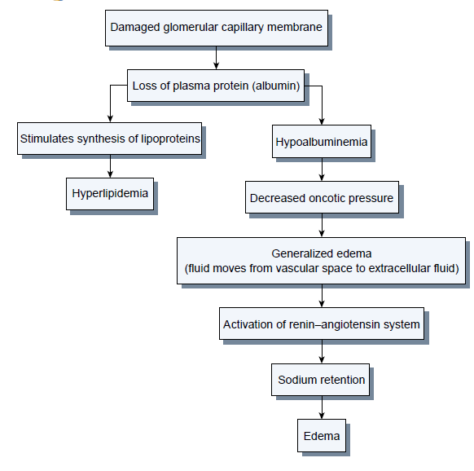
.

Slide 113
.
Clinical features
Oedema-The major manifestation
  usually soft and pitting and most commonly occurs around the eyes (periorbital), in dependent areas (sacrum, ankles, and hands) and in the abdomen (ascites).
Malaise,
Headache
Irritability
Fatigue
Hyponatremia

Slide 114
Features… NAPHROTIC
Na+ decrease( hyponatreamia)
Albumin decrease (hypoalbuminemia)
Proteinuria > 3.5g/day
Hyperlipidemia
Renal vein thrombosis
Orbital edema
Thromboembolism
Infections (due to loss of immunoglobulins)
Coagulability (due to loss of antithrombin III in urine)

Slide 115
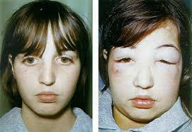
.

Slide 116
.
Investigations:
Proteinuria more than 3- 3.5g per day is sufficient for diagnosis of NS
Blood chemistry: hypoalbuminemia, hyperlipidemia
Renal biopsy(not very common in our set up): shows extent of tissue change
Medical Management:
Loop Diuretics and ACE inhibitors used for edema and to reduce protenuria
Immunosuppressants eg cyclosporin
Corticosteroids eg prednisolone
Maintain daily high biologic value protein (eg dairy products, eggs, meat) of 0.8g/kg/day
Low saturated fats and low sodium
Liberal potassium intake

Slide 117
.
Nursing care is the same as
AGN –in early stages
CRF -late stages
But include;
Monitoring fluid balance (daily wt, abdominal girth, Input &Out put)
Bed Rest in presence of extreme edema
Skin care
Health Education on:
  Medication regimen
  Nutrition
  Self-assessment of fluid status

Slide 118
POLYCYSTIC KIDNEY DISEASE
It is a disease characterized by abnormal fluid filled sacs that arise from the kidney tissue
May be single or multiple cysts (polycystic)
May affect one or both kidneys
The cause is unknown but the disease is hereditary
It can be associated with cysts in other organs- liver, pancreas, testes, ovary, uterus etc
It may cause End Stage Renal Disease(ESRD)
The cysts may become infected and rupture
Patient undergoing dialysis may develop multiple cysts in their non functioning kidneys

Slide 119
Pathophysiology:
Cysts enlarge within the kidney, causing pressure on renal blood vessels and functional tissue(nephrons)
Compression of vessels and nephrons results in renal failure

Slide 120
.
Clinical manifestations:
Enlarged kidneys(nephromegaly)
Abdominal or lumbar pain
Hematuria
Hypertension
Palpable renal masses
Oliguria
Recurrent UTI’s
Management:
There is no known method of preventing progress of the cyst.
Relieve pain in the patient.
Treat hypertension and UTI’s aggressively.
Initiate dialysis when signs of renal insufficiency appear

Slide 121
.
Advice patient to avoid sports & occupations that present a risk of trauma to the kidney to avoid rupturing the cysts.
If the cyst is large and unilateral, it can be drained percutaneously.

Slide 122
RENAL FAILURE
Temporary or permanent damage to the kidneys that results in loss of normal kidney functions
The substances normally eliminated in the urine accumulate in the body fluids as a result of impaired renal excretion
This leads to disruption in endocrine, metabolic, fluid and electrolytes, acid and base balance

Slide 123
Types
ACUTE RENAL FAILURE (ARF)
CHRONIC RENAL FAILURE (CRF)

Slide 124
ACUTE RENAL FAILURE (ARF)
Relatively sudden and almost complete loss of kidney filtration function over a period of hours to days that is potentially reversible.
It is characterized by anuria < 50 - 100 ml /24hrs or oliguria < 400ml /24hrs( which is more common)
But urine output can be normal or high

Slide 125
.
Regardless of the volume of urine excreted, there is a rising serum creatinine , BUN levels and retention of other metabolic waste products (azotemia) normally excreted by the kidneys
Therefore current definitions emphasize on a measurable increase in the serum creatinine (Cr) concentration
Retention of potassium is the most life-threatening effect of renal failure.

Slide 126
.
Clinical Classification
Pre-renal:Impaired renal blood flow → to decreased Glomerular perfusion and filtration
Intrarenal (intrinsic renal disease)-actual damage to renal tissue leading to dysfunctional nephron
Post-renal- involve mechanical obstruction to urine outflow

Slide 127
.
PRE RENAL
It results from impaired blood flow to the kidney causing hypo perfusion of the kidney & reduced glomerular filtration rate.
Common clinical situations that can cause pre renal ARF are
a). Hypovoleamia
  Renal losses (diuretics, polyuria)
  GI losses (vomiting, diarrhea)
  Cutaneous losses (burns, Stevens-Johnson syndrome)
  Hemorrhage

Slide 128
.
b). Decreased cardiac output
  Heart failure, myocardial infarction, cardiogenic shock
  Pulmonary embolus
  Acute myocardial infarction
  Severe valvular disease
  Abdominal compartment syndrome (tense ascites)

Slide 129
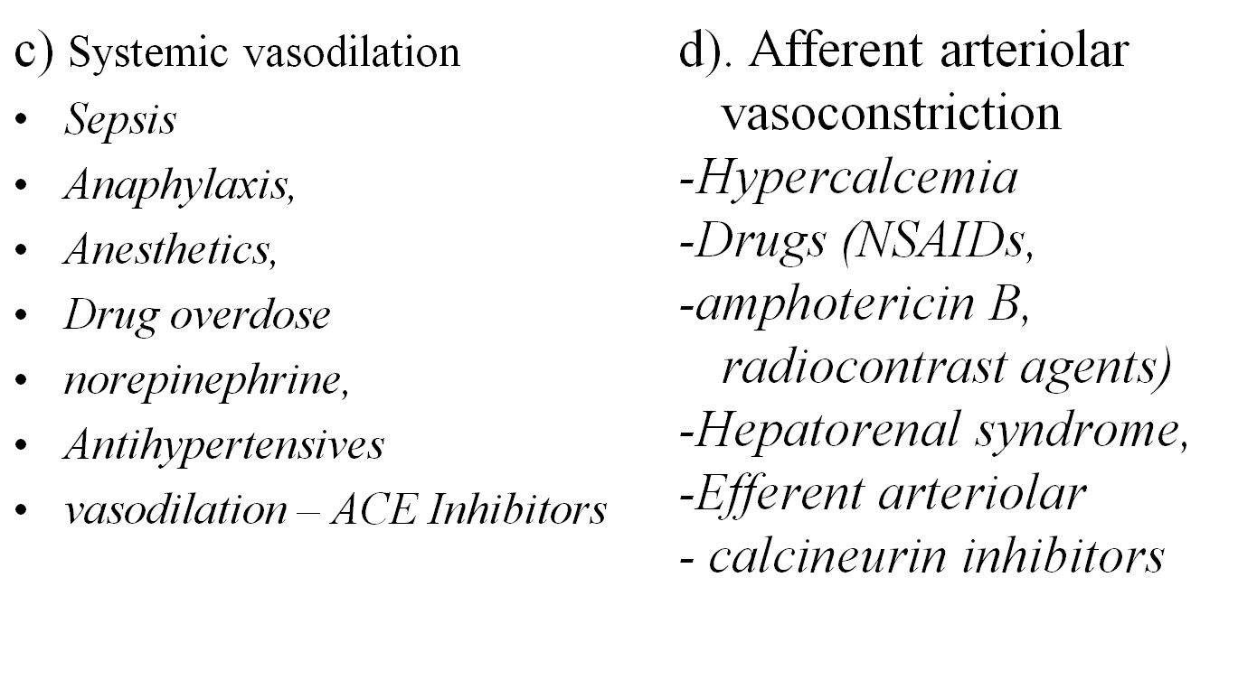

Slide 130
.
INTRA-RENAL CAUSES (INTRINSIC ARF)
Due to actual parenchymal damage to the kidney or glomerulus
a) Vascular
  Renal artery obstruction (thrombosis, emboli,)
  Renal vein obstruction (thrombosis)
  Malignant hypertension
  Transplant rejection
  b)Prolonged renal ischaemia
  resulting from myoglobinuria ( trauma, crush injuries, burns)
  Burns and injury leads to formation of myoglobin (a protein released from the muscles when injury occurs due to (rhabdomyolysis) and hemoglobin which causes renal toxicity and ischemia

Slide 131
.
  hemoglobinuria (transfusion reactions, hemolytic anaemia). Hemoglobin is filtered in the glomerulus to precipitation levels in the tubule
  c) Nephrotoxic agents
  Aminoglycosides antibiotics—gentamycin and tobramycin
  Heavy metals..lead and mercury
  NSAID, ACE Inhibitors, amphotericin B, allopurinol, rifampin, sulfonamides
  Solvents & chemicals- ethylene glycol, carbontetrachloride, arsenic
  d) Infectious processes:
  acute pyelonephritis
  acute glomerulonephritis

Slide 132
.
Postrenal causes of ARF
There is obstruction distal to the kidney, then pressure rises in the kidney tubules and eventualy GFR reduces
Causes
a) Ureteric obstruction
-stone disease (calculi), tumor, fibrosis, ligation during pelvic surgery
b) Bladder neck obstruction
-BPH (benign prostatic hyperplasia), CA prostate , Neurogenic bladder, TCA drugs, bladder tumor, stone, clot
c) Urethral obstruction
-strictures, tumor, phimosis

Slide 133
PATHOPHYSIOLOGY
Hypovolemia leads to a fall in mean systemic arterial pressure.
This reduces renal blood flow, nutrients and oxygen supply
This leads to activation of compensatory mechanisms eg RAAS system, release of vasopressin
Salt and water loss through the sweat glands inhibited, thirst and salt appetite increased
Vasodilation of afferent arteriole, and vasoconstriction of efferent arteriole to increase glomerular pressure and maintain GFR

Slide 134
.
With more severe hypoperfusion, these compensatory responses fail and GFR falls, leading to prerenal ARF
ARF occurs by
Ischaemia:→Disruption in the basement membrane and destruction in tubular epithelium
Nephrotoxic injury →necrosis of tubular epithelial cells which slough off and plug the tubules

Slide 135
.
Phases of Acute Renal Failure
There are four clinical phases of ARF: initiation, oliguria, diuresis and recovery.
1st phase Initiation period
This is when the kidney is affected by the disease
Begins with the initial insult and ends when oliguria develops.

Slide 136
.
2rd phase. Oliguria period
Results from ↓ Blood flow → ↓ Glomerular capillary pressure →GFR and tubular dysfunction
There is reduced output of urine less than 400mls/day
It is accompanied by a rise in the serum concentration of substances usually excreted by the kidneys (urea, creatinine, uric acid, organic acids and the intracellular cations [potassium and magnesium]).
The minimum amount of urine needed to rid the body of normal metabolic waste products per day is 400 mL.

Slide 137
.
Some patients have decreased renal function with increasing nitrogen retention, yet actually excrete normal amounts of urine (≥2 L/day).
This is the non-oliguric form of renal failure and occurs predominantly after administration of :
nephrotoxic antibiotic agents,
halogenated anesthetic agents ,
in burns and
traumatic injury
This period lasts 10-20 days.

Slide 138
.
3rd phase. Diuresis period
there is gradual increase of urine output indicating that glomerular filtration has started to recover.
Laboratory values stop rising and eventually decrease.
Although the volume of urinary output may reach normal or elevated levels, renal function may still be markedly abnormal.
Uremic symptoms may still be present, so the need for expert medical and nursing management continues.
Observe the patient closely for dehydration during this phase; if dehydration occurs, the uremic symptoms are likely to increase

Slide 139
.
4th phase. The recovery period
signals the improvement of renal function and may take
3 - 12 months.
Laboratory values return to the patient’s normal level although a permanent 1% to 3% reduction in the GFR is common, it is not clinically significant.

Slide 140
Signs and symptoms
1. Changes In Urine
Urine output varies (scanty to normal volume)
Hematuria may be present
Low specific gravity of ≤1.010 compared with a normal value of 1.015 to 1.025
Decreased Na⁺ (below 20 mEq/L) and normal urinary sediment in prerenal azotemia
Urinary sodium levels greater than 40 mEq/L with casts (mucoproteins secreted by the renal tubules in inflammation) and other cellular debris in intrarenal azotemia

Slide 141
.
2. Increased BUN & Creatinine Levels (Azotemia)
BUN level rises due to increased catabolism (breakdown of protein), and reduced renal perfusion
Serum creatinine rises in conjunction with glomerular damage.
3. Hyperkalemia- there is decreased GFR & the patient cannot excrete K⁺
Patients with oliguria and anuria are at greater risk for hyperkalemia
Protein catabolism results in the release of cellular K⁺ into the body fluids, causing severe hyperkalemia .
Hyperkalemia may lead to dysrhythmias and cardiac arrest.

Slide 142
.
4. Metabolic acidosis due to decreased excretion of hydrogen ions in urine.
Increased respiration in an attempt to correct metabolic acidosis, it removes excess carbon dioxide.
5. Calcium and Phosphorus Abnormalities
Increase in serum phosphate concentrations
Low serum calcium levels in response to decreased absorption of calcium from the intestine and as a compensatory mechanism for the elevated serum phosphate levels.

Slide 143
6. Anemia
Due to reduced erythropoietin production, uremic GI lesions, reduced RBC life span, and blood loss, usually from the GI tract (uremia alters the coagulation mechanism- makes platelets ineffective)
7. CNS changes
Occur due to effects of azotemia, urea and electrolyte imbalance and include;
  Drowsiness
  Twitching
  Seizures
  confusion

Slide 144
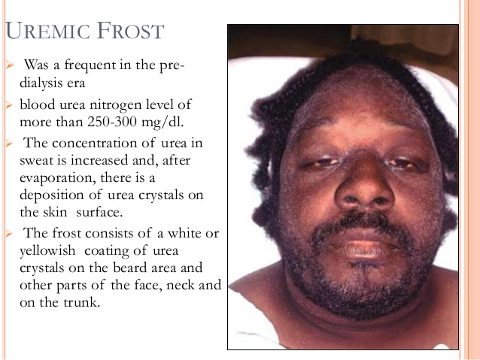
.

Slide 145
.
Management
Objectives of treatment of ARF are to;
restore normal chemical balance
prevent complications until repair of renal tissue and restoration of renal function can take place.
Interventions
Identify & treat cause of damage
Prerenal azotemia is treated by optimizing renal perfusion
Post renal failure is treated by relieving the obstruction.

Slide 146
.
Intrarenal azotemia management is supportive;
  Identify and remove the cause
    Improve renal blood flow
    Remove obstruction
    Discontinue toxic drugs
  Maintain renal function

Slide 147
.
Mngt ct'
1.Mannitol, furosemide, to initiate diuresis and prevent or minimize subsequent chronic renal failure.
2.Perform dialysis to correct biochemical abnormalities- e.g hyperkalaemia.
3Administer I.V fluids, blood products or albumin as appropriate to restore adequate blood flow to the kidneys

Slide 148
.
4Monitor and maintain fluid balance based on;
-daily body weight, fluid losses, blood pressure
-Parenteral and oral intake and the output of urine, gastric drainage, stools, wound drainage, and perspiration, insensible fluid lost through the skin and lungs
-serial measurements of central venous pressure, serum and urine concentrations

Slide 149
.
5. Observe signs of fluid overload
  Dyspnea, tachycardia, distended neck veins. moist crackles in the lungs.
6. Observe for edema - presacral and pretibial

Slide 150
.
7 Monitor patient for;
  hyperkalemia through serial serum electrolyte levels e.g tall, tented, or peaked T waves on ECG
  Na+ hyper or hyponatremia
  arterial blood gases to detect acidosis
  azotemia (nitrogenous compounds in blood)
8. Administer;
  Cation-exchange resins (oral) in hyperkalaemia and potassium binding using glucose 50%
  Potassium binders eg ca-resonium
  Low-dose dopamine (1 to 3 g/kg) to dilate the renal arteries through stimulation of dopaminergic receptors;

Slide 151
.
Administer;
  Phosphate-binding agents (aluminum hydroxide) in elevated serum phosphate level
  Atrial natriuretic peptide (ANP) to improve renal function this is normally produced by the heart. A powerful vasodilator
  Fluids and osmotic preparations to prevent ↓ renal perfusion, manage fluid volume & treat electrolyte imbalances
  Antibiotics to prevent infection

Slide 152
.
Skin care (remove urea crystals)
Teach patient on;
  Dietary restrictions
  Medication regimen
  Signs of infection and where to seek help

Slide 153
.
Nutritional Therapy
The patient is weighed daily and can be expected to lose 0.2 to 0.5 kg /day if the nitrogen balance is negative
Low proteins to about 1 g/kg
High-carbohydrate diet
Restrict potassium to 40 to 60 mEq/day
Low phosphorus
Restrict sodium restricted to 2 g/day.

Slide 154
Prevention of acute renal failure
provide adequate hydration to patients at risk of dehydration
Prevent and treat shock promptly with fluids or blood transfusion
Monitor the arterial and central venous pressure hourly of critically ill patients to detect the onset of renal failure
Treat hypotension promptly
Continuous assessment of renal function e g renal output
Ensure correct blood transfusion to avoid transfusion reactions
Treat infections promptly
Meticulous care to patients with indwelling catheters
Monitor dosage, duration of use of nephrotoxic drugs which are metabolized and /or excreted by kidney

Slide 155
.
NURSING MANAGEMENT:
Assessment:
Assess the patients medical history for any factors that may lead to renal failure.
Assess urological function i.e. fluid intake & output. Oliguria or concentrated urine.
Establish basal body weight & vital signs for reference.
Nursing diagnosis:
Fluid and electrolyte imbalance related to altered glomerular filtration.

Slide 156
.
Altered nutrition less than body requirements related to nausea & vomiting…
High risk for infection related to lowered immunity...
Knowledge deficit on the cause of the disease & treatment regimen…
Altered breathing patterns related to metabolic acidosis as evidenced by increased respiration…
Risk for impaired skin integrity related to edema…
Anxiety related to unknown outcome of disease process…
Goals:
Maintain fluid & electrolyte balance
Maintain normal nutritional status
Prevent infection
Maintain skin integrity
Allay anxiety.

Slide 157
.
Interventions:
Monitor the patients serum electrolyte levels & physical indicators of complications.
Parenteral solutions & oral intake should be carefully selected according to the patients fluid & electrolyte status.
Monitor patients cardiac function & musculoskeletal status closely for signs of hyperkalemia.
Monitor fluid status by paying close attention to fluid intake, urine output, edema, distention of jugular veins, alterations in heart & breath sounds and increased difficulty in breathing.
Accurate daily weighing.
Hyperkalemia is treated with 50%dextrose, insulin & calcium gluconate ( potassium binding) or dialysis.

Slide 158
.
For adequate nutrition provide a high carbohydrate low protein diet in oliguric phase but increase protein in diuretic phase.
Assist patient to turn, cough, take deep breaths frequently to prevent atelectasis & respiratory tract infection.
Maintain asepsis with invasive lines & catheters to minimize the risk of infection.
Avoid indwelling catheters whenever possible due to high risk of UTI.
Frequent turning, keeping skin clean & well moisturized to prevent skin breakdown.
Give patient & family psychological support.
Bed rest to reduce exertion & metabolic rate.

Slide 159
Chronic renal failure or End Stage Renal Disease (ESRD)
Def:
is a progressive, irreversible deterioration in renal function characterized by inability to maintain metabolic, fluid and electrolyte balance resulting in uremia or azotemia (retention of urea and other nitrogenous wastes in the blood).
Dialysis or kidney transplant will be required to maintain life

Slide 160
Etiology
Arises from any disease processes that compromise the renal blood perfusion
Renal diseases -Pyelonephritis, chronic glomerulonephritis, chronic urinary obstruction, Autosomal dominant polycystic kidney.
Systemic diseases, such as diabetes mellitus hypertension; vascular disorders; infections;
Medications or Environmental/occupational toxic agents-lead, mercury and chromium.

Slide 161
Pathophysiology
As the renal function declines, the end products of protein metabolism, which are normally excreted in urine, accumulate in the blood.
GFR falls and serum urea nitrogen & creatinine levels increases
Uremia develops and adversely affects every system in the body
When GFR is less than 10 – 20mls/min, the effect of uremic toxins on the body becomes evident.
The greater the build up of waste products, the more severe the symptoms.
Three well-recognized stages of chronic renal disease result from the pathophysiology

Slide 162
Stages of Chronic Renal Disease
Stage 1:Reduced renal reserve,
Characterized by a 40% to 75% loss of nephron function.
There are No symptoms because the remaining nephrons are able to carry out the normal functions of the kidney. (renal reserve function)
Stage 2:Renal insufficiency
Occurs when 75% to 90% of nephron function is lost.
Increase in Serum creatinine and BUN
Kidney loses its ability to concentrate urine
Presence of Anemia
Presence of polyuria and nocturia.

Slide 163
.
Stage 3:End-stage renal disease (ESRD)
The final stage of chronic renal failure,
Occurs when there is less than 10% nephron function remaining.
All of the normal regulatory, excretory, and hormonal functions of the kidney are severely impaired
ESRD is evidenced by elevated creatinine and blood urea nitrogen levels as well as electrolyte imbalances.
At this point, dialysis is indicated
Many of the symptoms of uremia are reversible with dialysis

Slide 164
.
Staging is also based on GFR. Normal is 125mls/min. GFR is the amount of plasma filtered through the glomeruli per unit time.
A 5 stage classification is used to indicate the stages based on the GFR.
stage 1: kidney damage with normal or increased GFR. GFR is greater than 90ml/min.
stage 2: GFR 60 – 89ml/min mild decrease in GFR
Stage 3: GFR 30 – 59ml/min moderate decrease in GFR
Stage 4: GFR 15 – 29ml/min. severe decrease in GFR
Stage 5: GFR less than 15ml/min kidney failure

Slide 165
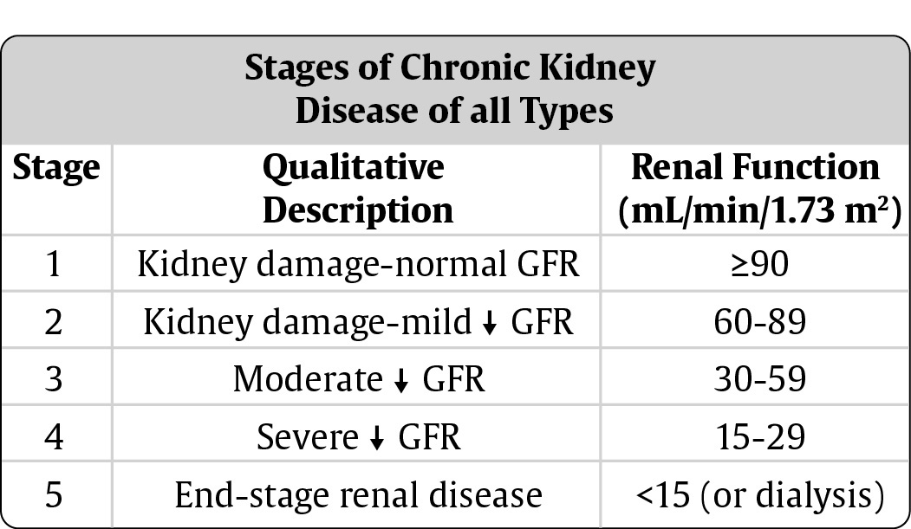
.

Slide 166
Clinical Manifestations
The severity of the signs and symptoms depends in on the degree of renal impairment, other underlying conditions, and the patient’s age.
1.Cardiovascular manifestations
Hypertension (due to sodium and water retention or from activation of the renin–angiotensin–aldosterone system)
Heart failure and pulmonary edema (due to fluid overload)
Pericarditis (due to irritation of the pericardial lining by uremic toxins)
Pitting edema (feet, hands, sacrum); periorbital edema;
Pericardial friction rub; engorged neck veins; pericardial effusion; pericardial tamponade;
Hyperkalemia; hyperlipidemia

Slide 167
.
2. Dermatologic symptoms
Severe itching (pruritus) is common, ecchymosis; purpura;
Thin, brittle nails; coarse, thinning hair
Uremic frost, the deposit of urea crystals on the skin(Gray-bronze), is uncommon today because of early and aggressive treatment of ESRD with dialysis.
3. Neurologic:
Weakness and fatigue; confusion; inability to concentrate; disorientation; tremors; seizures; restlessness of legs; behavior changes

Slide 168
.
4. Pulmonary: Crackles; thick, tenacious sputum; depressed cough reflex; pleuritic pain; shortness of breath; tachypnea; uremic pneumonitis; “uremic lung”
5. Hematologic: Anemia; thrombocytopenia
6. Renal: Anuria (output < 50 mL/day), Acidosis
7. Gastrointestinal: Ammonia odor to breath (“uremic fetor”); metallic taste (dysgeusia); mouth ulcerations and bleeding; anorexia, nausea, and vomiting; hiccups; constipation or diarrhea; bleeding from gastrointestinal tract

Slide 169
.
8. Musculoskeletal: Muscle cramps; loss of muscle strength; renal osteodystrophy; bone pain; bone fractures; foot drop
9. Reproductive: Amenorrhea; testicular atrophy; infertility; decreased libido Endocrine alterations
10. Psychological: depression, anxiety

Slide 170
Management
The goal of management is to maintain kidney function and homeostasis for as long as possible
All factors that contribute to ESRD and all factors that are reversible (eg, obstruction) are identified and treated
Management is accomplished primarily with
- Medications
- Diet therapy and
-Dialysis

Slide 171
Pharmacotherapy
Antihypertensive, Erythropoietin, Diuretics, Iron supplements,
Phosphate-binding agents, and Calcium supplements.
Antacids for Hyperphosphatemia and Hypocalcemia.
Inotropic agents such as digitalis or dobutamine and dialysis.
Sodium bicarbonate supplements or dialysis to correct the acidosis
Anticonvulsants (control seizure), Hematemics, Vitamin supplements, Antiemetic's, Antipruritic’s

Slide 172
Nutritional therapy
Careful regulation of protein intake, fluid intake
Sodium intake to balance sodium losses and some restriction of potassium.
Adequate caloric intake and vitamin supplementation
Protein is restricted because urea, uric acid, and organic acids are accumulation of breakdown products of dietary and tissue proteins
The allowed protein must be of high biologic value (dairy products, eggs, meats). Maintained at 0.8g/kg/day

Slide 173
.
Fluid allowance is 500 to 600 mL more than the previous day’s 24-hour urine output.
Calories are supplied by carbohydrates and fat to prevent wasting.
Vitamin supplementation
  protein-restricted diet does not provide necessary complement of vitamins.
  patient on dialysis may lose water-soluble vitamins from the blood during the dialysis treatment

Slide 174
.
Other Therapy:
DIALYSIS
Cation-exchange resin
Transplantation

Slide 175
NURSING CARE OF A PATIENT WITH CHRONIC RENAL FAILURE:
Risk for electrolyte imbalance
Vulnerable to changes in serum electrolyte levels, which may compromise health.
Excess fluid volume related to decreased urine output, dietary excesses & retention of sodium & water.
goal: maintenance of ideal body weight without excess fluid.
interventions:
Assess fluid status through:
  Daily weight
  Input & output balance
  Skin tugor & presence of edema
  Distension of neck veins
  BP, pulse rate & rhythmn
  Respiratory rate & effort.
b) Limit fluid intake to prescribed volume
Identify potential sources of fluids e.g. medication, foods

Slide 176
.
d) Explain to patient and family rationale for fluid restriction to ensure cooperation.
Assist patient to cope with the discomfort resulting from fluid restriction e.g. cool water gargles.
Provide and encourage frequent oral hygiene to decrease dryness of the oral mucus membrane.
Imbalanced nutrition less than body requirements related to anorexia, nausea, vomiting, dietary restrictions & altered oral mucous membrane .
goal: maintenance of adequate nutritional intake
interventions:
Assess nutritional status through:
  Weight changes
  Lab values – serum electrolyte, BUN, creatinine, protein, iron etc.

Slide 177
.
Assess patient dietary patterns
  Diet history
  Calories
  Food preferences
Assess for factors contributing to altered nutritional intake
  Anorexia, nausea, vomiting
  Unpalatable diet
  Depression
  Lack of understanding of dietary restrictions
  Stomatitis
Promote intake of high biologic value protein foods
Encourage high calorie, low protein, low sodium & low potassium snacks between meals.
Explain rationale for dietary restriction & relationship to kidney disease & increased UEC’s (…………)

Slide 178
.
Provide written lists of foods allowed & suggestions for improving their taste.
Daily weighing
Assess for evidence of inadequate protein intake such as:
  Edema
  Delayed wound healing
  Decreased serum albumin.
Knowledge deficit regarding condition & treatment
interventions;
Assess knowledge on cause, consequences & treatment of renal failure.
Explain the condition and its management to its patients.
Assist to identify ways to incorporate changes related to illness and its treatment into lifestyle.

Slide 179
.
Provide oral & written information about renal function, failure, fluid & dietary restrictions, medication & follow up.
Activity intolerance related to fatigue, anaemia, retention of waste products & dialysis procedure.
Assess factors contributing to activity intolerance: fatigue, anaemia, fluid & electrolyte imbalance.
Promote independence in self care activities as tolerated.
Alternate activity with rest.

Slide 180
DIALYSIS
It refers to the process of artificial removal of uremic waste products & excess water in the body.
It is used to treat patients with edema not responding to other treatments, hyperkalemia, hypercalcemia, hypertension & uremia.
The need for dialysis may be acute or chronic.
Acute dialysis is indicated when there is hyperkalemia, fluid overload or impending pulmonary edema, increasing acidosis, pericarditis & severe confusion, certain meds and other toxins (poisoning overdose in the blood

Slide 181
.
Chronic/ maintenance dialysis is indicated in ESRD in:-
  Uremic signs & symptoms like nausea, vomiting, severe anorexia, increasing lethargy, mental confusion.
  Hyperkalemia
  Fluid overload not responsive to diuretics & fluid restriction.
  Pericardial friction rub in ESRD (urgent indication)
Patients with no renal function can be maintained on dialysis for years.

Slide 182
.
Principles of dialysis:
  Ultrafiltration
  Diffusion
  Osmosis
Diffusion
Toxins and wastes in the blood are removed by diffusion from an area of higher concentration in the blood to an area of lower concentration in the dialysate
Osmosis
Movement of a solvent such as water across a semi permeable membrane from areas of less solute to areas of high concentration of solute.

Slide 183
.
Ultrafiltration
Movement of a fluid across a semi permeable membrane from a high pressure area to a low pressure area.
It is more efficient in removal of water than osmosis. Negative pressure is created against a dialysis membrane to draw water from blood.

Slide 184
HEMODIALYSIS
Most commonly used method for acutely ill patients, those that require short term dialysis & for patients with ESRD who require long term or permanent dialysis/therapy
Common components of hemodialysis are:-
  Dialyzer
  Clot & bubble trap
  Blood pump
  BP monitor
  Dialysate flow system
  Blood lines
  Heparin pump

Slide 185
.
Dialyzer:-
They are hollow fiber devices containing thousands of tiny cellophane tubules that act as semi permeable membranes, replacing the renal glomeruli & tubules.
The blood flows through the tubules while a solution(dialysate) circulates around.
The exchange of wastes from blood to dialysate occurs through a semi-permeable membrane of tubules.
Because of cost, dialysers are reused in some centres upon sterilization.
Blood lines:
Are plastic synthetic tubes which take blood from the patient to the dialyser & back to the patient. They are discarded once used.

Slide 186
.
Blood pump:
Creates a suction force that circulates blood through hemodialyser.
Heparin pump:
In blood that has come into contact with synthetic material, clotting is likely.
To prevent this blood is injected with heparin mixed with normal saline to ensure it doesn’t clot in the blood lines.

Slide 187
Clot & bubble trap:
Trap and prevent embolising the patient with air or blood clot.
It filters blood and allows any air to escape.
Dialysate flow system:
System of pump which takes the dialysate through the dialyser in a counter – current version.
Treatment usually occurs three times a week for 3 – 4 hours per treatment. The body’s buffer system is maintained using a dialysate bath made up of bicarbonate ( most common) or acetate which is metabolised to form bicarbonate.
The cleaned blood is returned to the body after the removal of many waste products and the restoration of electrolyte balance.

Slide 188
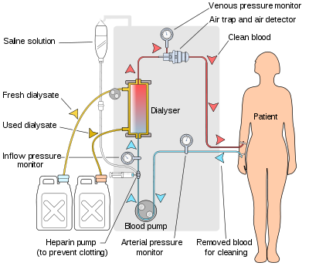
Basic diagram of a hemodialyser

Slide 189
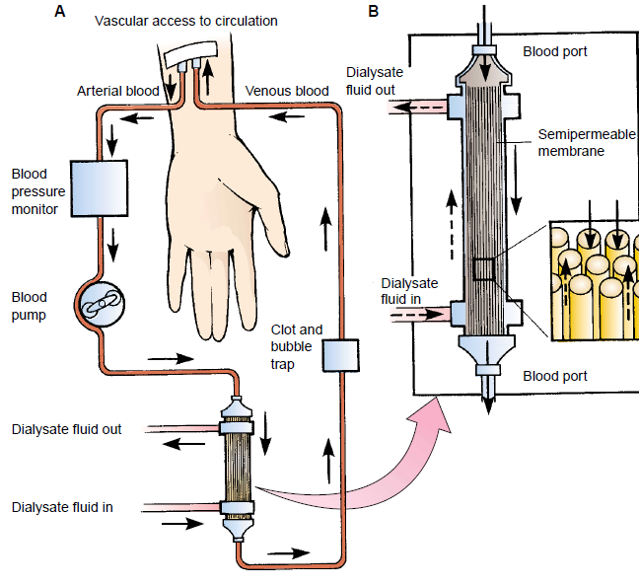
.

Slide 190
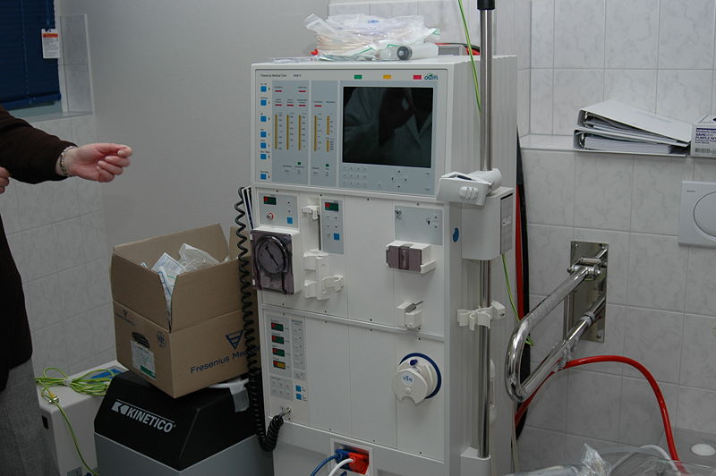


Slide 191
.
Vascular access:
Access to the patients vascular system must be established to allow blood to be removed, cleansed & returned to the patients vascular system.
Several types of access available are:-
  Use of large veins
  Use of fistulae
  Use of grafts.
Use of large veins:
Used in immediate access to the patients circulation for acute hemodialysis & is achieved by inserting a double lumen catheter into the subclavian, internal jugular or femoral vein.
This method involves risks like hematoma, pneumothorax, infection, thrombosis of the subclavian vein.

Slide 192
.
While not in use it is heparinised to prevent blood from clotting & is covered with a sterile dressing.
The catheter is removed when no longer needed e.g. if patients condition improves or another type of access has been established.
Double lumen, cuffed catheters may also be inserted into the internal jugular vein of the patients requiring a central venous catheter for dialysis. These catheters are used for long term access.
Arteriovenous fistula:
It is the preferred method of permanent access.
It is created surgically usually in the forearm by anastomozing(joining) an artery to a vein
Since this bypasses the capillaries, blood flows rapidly through the fistula
Usually created on the non-dominant hand

Slide 193
.
Needles are inserted into the vessel to obtain blood flow adequate to pass through the dialyser.
The arterial segment of the fistula is used for arterial flow to the dialyser and the venous segment for reinfusion of the dialysed blood.
The fistula should be allowed at least 14 days to mature ( allow for healing & dilation of the venous segment).
Needle of gauge 14 – 16 are used for taking blood from & to the patient.
The patient is encouraged to exercise to increase the size of the vessel.

Slide 194
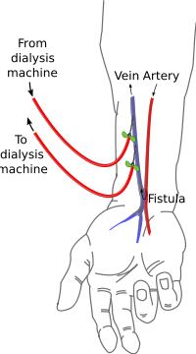
.

Slide 195
.
III. Arteriovenous graft:
It is created subcutaneously using biologic or synthetic graft material interposing between an artery and a vein.
Usually a graft is created when the patients vessels are not suitable for creation of a fistula e.g those with compromised vascular system as in DM
Infection & thrombosis are the most common complications of arteriovenous graft

Slide 196
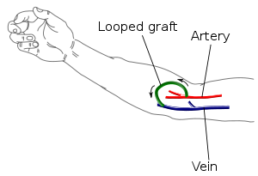
.

Slide 197
.
.
Complications of hemodialysis:
Disturbance of lipid metabolism – hypertryglyceridemia – which is accentuated by hemodialysis causing atherosclerosis leading to heart failure, coronary heart disease & anginal pain.
Gastric ulcers & other GI problems resulting from the physiologic stress of chronic illness & medication.
Disturbed calcium metabolism leads to bone pain & fractures ( renal osteodystrophy).
Sleep disturbance in 85% of patients undergoing hemodialysis.
Painful muscle cramping due to rapid fluid shift from the extravascular space.
Hypotension if too much fluid is eliminated..signs of hypotension..nausea and vomiting, diaphoresis, dizziness and tachycardia.

Slide 198
.
Blood loss if blood lines separate or dialysis needles dislodge.
Air embolism- rare- but can occur if air enters the vascular system .
Dialysis disequilibrium due to rapid fluid shift from the cerebral fluid & its characterised by headache, nausea, vomiting, restlessness, decreased level of consciousness & seizures.
Dysrrythmias due to electrolyte & pH changes
Infection during venous access
Heparin allergy may cause low platelet count and bleeding

Slide 199
.
Haemodialysis Assessment
Before dialysis
Baseline vital signs
Determine fluid status
  Analyzing weight (current Vs Dry weight)
  Skin turgor
  Mucous membranes
  Oedema
  Jugular vein distension
  Intake vs output

Slide 200
.
Establish serum electrolyte levels
Current medications and their effects on renal functions
Perform Systematic cardiovascular, respiratory, neurologic and other renal function tests
Monitor lab reports before initiating dialysis
Determine the status of vascular access system/device-patency
Determine availability and functional state of the equipment
Availability and maintenance of aseptic techniques and standard precaution procedures

Slide 201
.
Peritoneal dialysis(PD)
PD is performed by surgically placing a special, soft, Catheter into the lower abdomen near the umbilicus.
Dialysate is instilled into the peritoneal cavity and is left in situ for a designated period of time which will be determined by the nephrologist
The dialysate fluid absorbs the waste products and toxins through the peritoneum which acts as the semipermiable membrane
The fluid is then drained from the abdomen, measured, and discarded.
Indicated for patients who are unable or unwilling to undergo hemodialysis or kidney transplant

Slide 202
.
Principles
Peritoneum (capillary endothelium, matrix, mesothelium) = semipermeable dialysis membrane through which fluid and solute move from blood to dialysis solution via diffusion
Effective peritoneal surface area = perfused capillaries closed to peritoneum
ultrafiltration (movement of water) enabled by osmotic gradient generated by glucose or glucose polymers (isodextrin) in the dialysate solution

Slide 203
.
The access for infusing the dialysate solution is a peritoneal catheter
In peritoneal dialysis, there is no machine.
Instead of an artificial filter, the lining of the abdomen, the peritoneum is used as a natural filter.
The peritoneum has a lot of small vessels in it.
With peritoneal dialysis, it takes 36 – 48 hours to achieve what hemodialysis accomplishes in 6 – 8 hours

Slide 204
.
Performing the exchange
  Peritoneal dialysis involves a series of exchanges of cycles. An exchange is defined as the infusion, dwell & drainage of the dialysate.
  The dialysate(2-3litres) is infused by gravity into the peritoneal cavity in 5-10 minutes
  The dwell or equilibration time allows diffusion & osmosis to occur .dwell ( time when the dialysate solution is in the peritoneum
  At the end of dwell time, the tube is unclamped and the solution drains from the peritoneal cavity by gravity in 10 – 30 minutes.
Note colour of drainage, normally colorless or straw colored.
The entire exchange takes 30 – 45 minutes.
The number of exchanges/cycles depends on the patients physical status.

Slide 205
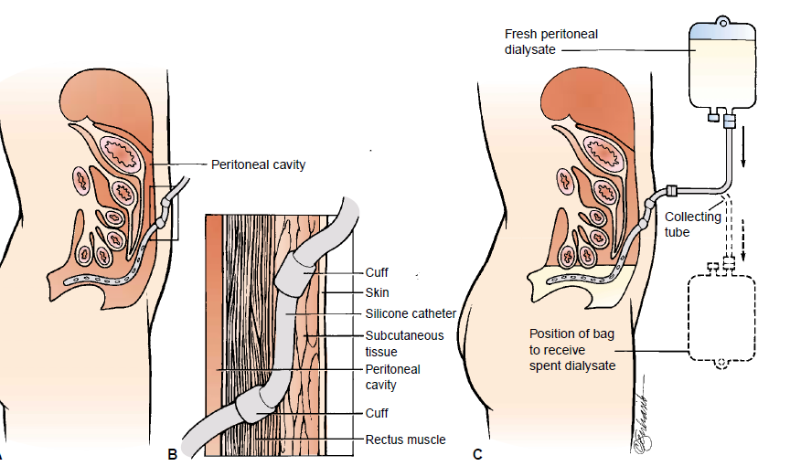
.

Slide 206
.
Absolute contra-indications of PD:
Peritoneal fibrosis and adhesions following intraabdominal operations
Inflammatory gut diseases
Relative contraindications
pleuro-peritoneal leakage
Hernias, arthritis,
Psychosis
significant decrease of lung functions
significant groin pain
big polycystic kidneys
colostomy

Slide 207
.
Types of peritoneal dialysis:
  continuous ambulatory peritoneal dialysis (CAPD)
  continuous cyclic peritoneal dialysis (CCPD)
  intermittent peritoneal dialysis (IPD)
They use the same principle of diffusion and osmosis

Slide 208
.
Complications of PD
Exit-site inflammation (flare, suppurative secretion,Granulation)
Peritonitis (turbid/ cloudy dialysate, abdominal pain, fever)
Hernias
Hydrothorax
Leakage of dialysate along the peritoneal catheter
Drainage failure of dialysate (dislocation or catheter obstruction by fibrin)
Perforation of the peritoneum
Increased intra-abdominal pressure
Muscle cramps, nausea and vomiting

Slide 209
.
NURSING CARE OF A PATIENT UNDERGOING DIALYSIS
Protecting vascular access sites from damage. Assess vascular access sites for patency and ensure the extermity with the vascular access is not used to measure BP, tight dressings, restraints or jewellery.
  Assess for thrill or bruit every 8 hrs over the venous access site. Absence will indicate blockage or clotting.
  Observe for signs & symptoms of infection – redness, swelling, drainage from exit site, fever & chills.
  Assess the integrity of the dressing & change it as needed.
keep accurate intake – output records. IV therapy should be done with caution due to risk of fluid overload.
Monitor for symptoms of uraemia………
Detect cardiac & respiratory complications – crackles at the base of the lungs, substernal chest pain, muffled or inaudible heart sounds.

Slide 210
KIDNEY/ RENAL TRANSPLANTATION
Definition:
A surgical procedure performed to replace a diseased kidney with a healthy kidney.
It involves the surgical attachment of a functioning kidney, or graft, from a donor to a patient with end-stage renal disease (ESRD).
History : The First successful transplant – 1954
Sources of kidney
Deceased-donor (formerly known as cadaveric ) kidneys
Living transplant /Live donor kidneys on ABO and cross match from close relatives, friends or non-related
Eligible Patients
Patient must have evidence of ESRD defined as current or impending dialysis dependency

Slide 211
.
Indications
Glomerulonephritis…chronic renal failure (55%)
Diabetic nephropathy (20-30%)
Chronic pyelonephritis (8%)
Polycystic kidney disease (5%)

Slide 212
Contraindications
Active, Systemic malignancy.
Active infection Seropositivity, i.e., HIV, Hepatitis B Noncompliant patient
Cancer in which immunosuppression may enable tumor growth.
Cirrhosis
Active mental illness or substance abuse

Slide 213
Preoperative preparation & management
A complete physical examination is performed and treatment of any infections or conditions that could cause complications after transplant.
The donor should be under 55 years with normal renal function and no evidence of cardiac or hepatic diseases, prolonged hypertension, any infectious or communicable disease, abdominal or kidney trauma.
Blood tests
Blood chemistries - serum creatinine, electrolytes (such as sodium and potassium), cholesterol, and liver function tests..liver enzymes
Clotting studies, such as prothrombin time (pt) and partial thromboplastin time (ptt)

Slide 214
.
Matching donors and receipints- type A+, A-, B+, B-, AB+. AB-, O+, or O-
The success rate increases if the kidney transplantation from a living donor is performed before dialysis is initiated
Hemodialysis is performed the day before the scheduled transplantation procedure only if a dialysis routine had already been established

Slide 215
.
Patient & donor preparation:
Living donor is assessed for physical & emotional health.
Donor must make fully informed decision without being coerced by relatives.
The recipient should be treated for any condition that could cause complication with the transplant.
He must be free from infection because they will be put on immunosuppresants post-operatively

Slide 216
.
Surgical Technique
The patient and donor are operated on at the same time, incase of cadaver donor, the kidney is preserved until surgery
The kidney is placed in the illiac fossa.
Its ureter is connected to the bladder or anastomosed with the previous ureter.
The renal artery and vein are tied off & the renal artery & vein of the new kidney are sutured to the illiac artery & vein respectively.
In most cases, the diseased kidneys are left in place during the transplant procedure.

Slide 217
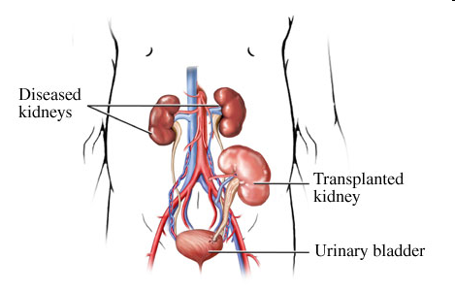
.

Slide 218
.
POST-OPERATIVE MANAGEMENT:
The survival of the transplanted kidney depends on the ability to block the body’s immune response to the transplanted kidney
Immunosuppressive agents are administered e.g. cyclosporine.
Corticosteroids are avoided due to long term side effects.
Dosages are gradually reduced over a period of several weeks depending on the patients immunological response to transplant.
However, the patient is required to take some form of immunosuppressive therapy the entire time he/she has the transplanted kidney.

Slide 219
.
NURSING MANAGEMENT
Assess for transplant rejection- S&S include oliguria, edema, fever, increasing BP, weight gain & swelling or tenderness over the transplanted kidney. .
Rejection can be hyperacute i.e. within 24 hours, acute within 3-14 days or chronic from 14 days to several years
Prevent infection – FHG, platelet count because immunosuppression depresses formation of leukocytes & platelets.
Monitor for signs of infection- chills, fever, tachycardia, tachypnea.
Urine culture should be done frequently to rule out bacteriuria in early & late stages.
Protect from exposure to infection by staff, visitors and patients. Encourage hand hygiene.
Monitor kidney function- a kidney from a living donor may function immediately producing large amounts of dilute urine.
A cadaver kidney may undergo acute tubular necrosis with oliguria & anuria therefore monitor output, and may not function for 2-3 weeks.
Hemodialysis may be required to maintain homeostasis until the transplanted kidney functions well especially in hyperkalemia and fluid overload.

Slide 220
.
Psychological care – due to anxiety & fear of rejection of the kidney, complications of immunosuppresive therapy ( cushing’s syndrome, diabetes, capillary fragility etc). Assess coping mechanisms.
Monitoring and managing potential complications associated with surgical procedure. Prevent their occurrence by breathing exercises, early ambulation, care of incision site.
Teaching self care – importance of continuing with immunosuppresants, signs & symptoms of transplant rejection, infection or adverse effects of immunosuppressive drugs ( decreased urine output, weight gain, fever, respiratory distress)
Teach on importance of follow up.
Instruct on diet, medication, fluids, daily weight measurement, management of intake – output, infection prevention, resumption of activity

Slide 221
.
Complications
Transplant Rejection
Renal graft rejection and failure may occur within 24 hours (hyperacute), 3 to 14 days (acute) or after many years (chronic).
Signs and symptoms of rejection
Ultrasonography indicates enlargement of the kidney;
Percutaneous renal biopsy (most reliable) and x-ray techniques are used to evaluate transplant rejection
fever
tenderness over the kidney
elevated blood creatinine level
high blood pressure

Slide 222
.
Preventing Transplant Rejection.
The anti-rejection medications most commonly used include:
cyclosporine
tacrolimus
azathioprine
mycophenolate mofetil
prednisone
antithymocyte Ig (ATGAM)

Slide 223
Other complications
Surgical Complications
Early Anuria & Oluguria
Acute Tubuler Necrosis (ATN)
Others
  Infections
  Tumors,
  Hepatitis,
  Diabetes
wound infection

Slide 224
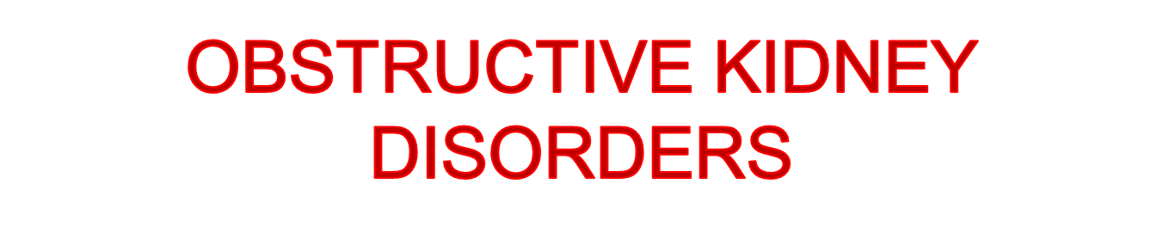
KIDNEY STONES/ UROLITHIASIS/NEPHROLITHIASIS
It refers to the presence of calculi (stones) in the urinary system.
Calculi is a mass of precipitated material derived from mineral salts & acids due to super saturation.
Kidney stones may form anywhere from the kidney to the bladder & vary in size from minute granular deposits, the size of sand & gravel to bladder stones as large as an orange!!!!
About 75% of renal stones are calcium based (Ca oxalate, Ca phosphate, uric acid or Mg phosphate)
Predisposing factors:
Age- common between the 3rd – 5th decade of life.
Lifestyle- sedentary lifestyle causes slowing of renal drainage.

Slide 225
.
Hypercalcemia- abnormally high concentrations of blood calcium compounds.
Hypercalciuria- abnormally high amounts of calcium in urine. Both can result due to hyperthyroidism or excessive Vit D intake, excessive intake of milk
Overdosage of ascorbic acid (vitamin C) as it promotes secretion of oxalic acid and oxalates.
Hyperuricosuria- high levels of uric acid secretion in urine caused by a diet rich in purines and over production of uric acid e.g in presence of gout
Neurogenic bladder---
Anatomic derangements e.g. polycystic kidney disease, horseshoe kidneys, chronic strictures
Medications- antacids, acetazolamide, Vit D, laxatives, high doses of asprin.

Slide 226
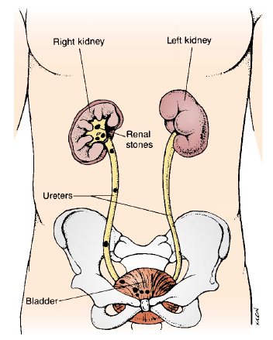
Various sites of stone formation

Slide 227
.
CLINICAL FEATURES
Pain – depends on the size and location of the stone. Small stones may be asymptomatic.
In the renal pelvis, pain is intense and deep in the costovertebral angle CVA.
Pain from the renal area radiates anteriorly and downward towards the bladder in the female and towards the testes in the male.
If pain suddenly becomes acute, with tenderness over the costovertebral angle accompanied by nausea and vomiting, it is called renal colic.
In the ureters, the pain is acute, excruciating, colicky, wavelike radiating down the thigh & genitalia.
Patient has desire to void with little urine passed containing blood

Slide 228
.
Hematuria- because of abrasive action of stones
Diarrhoea & abdominal discomfort due to proximity of kidney to GIT
Stones lodged at the ureterovesical junction → urinary frequency and dysuria
Symptoms of obstruction- hydronephrosis. Stasis of urine promotes bacterial growth which leads to ascending infections that present with fever.

Slide 229
.
ASSESSMENT & DIAGNOSTIC FINDINGS:
Radiology- x-ray of Kidney Ureters & bladder(KUB), ultrasound, IV urography, retrograde pyelography. to confirm diagnosis.
24 hour urine test for measurement of calcium, uric acid, creatinine, sodium, pH, total volume (urinalysis)
Dietary & medication history. Family history of kidney stones.
renal ultrasound - determines the size and shape of the kidney, and to detect a mass, kidney stone, cyst, or other obstruction in the kidney.

Slide 230
MANAGEMENT
Goals
-determine the stone type
-to eradicate the stone,
-prevent destruction of the nephron,
-control infection and
-relieve any obstruction present.
Opiod analgesics for excruciating pain and NSAID’s to relieve pain and reduce swelling.
Hot baths and moist heat to flank areas to relieve pain.
Encourage fluids as this increases hydrostatic pressure behind the stone, assisting it in its downward passage( aim for urine output ≥ 2 l/day).

Slide 231
.
SURGICAL MANAGEMENT:
Ureteroscopy- involves visualising the stone, inserting a ureteroscope into the ureter then inserting a laser or ultrasound device to fragment the stone.
Extracorporeal shock wave lithotripsy- non invasive high energy shock wave is generated which fragments the stone and the fragments are voided.
Nephrolithotomy- incision into the kidney to remove the stones.
Pyelolithotomy- removal of stones from the renal pelvis.
Uretolithotomy- removal of stones from the ureters.
Electrohydraulic lithotripsy- electrical discharge is used to create hydraulic shock waves to break up the stone by passing a probe through a cystoscope.
Chemolysis- stone dilution using infusions of chemical solution e.g alkylating agents to dissolve the stone.

Slide 232
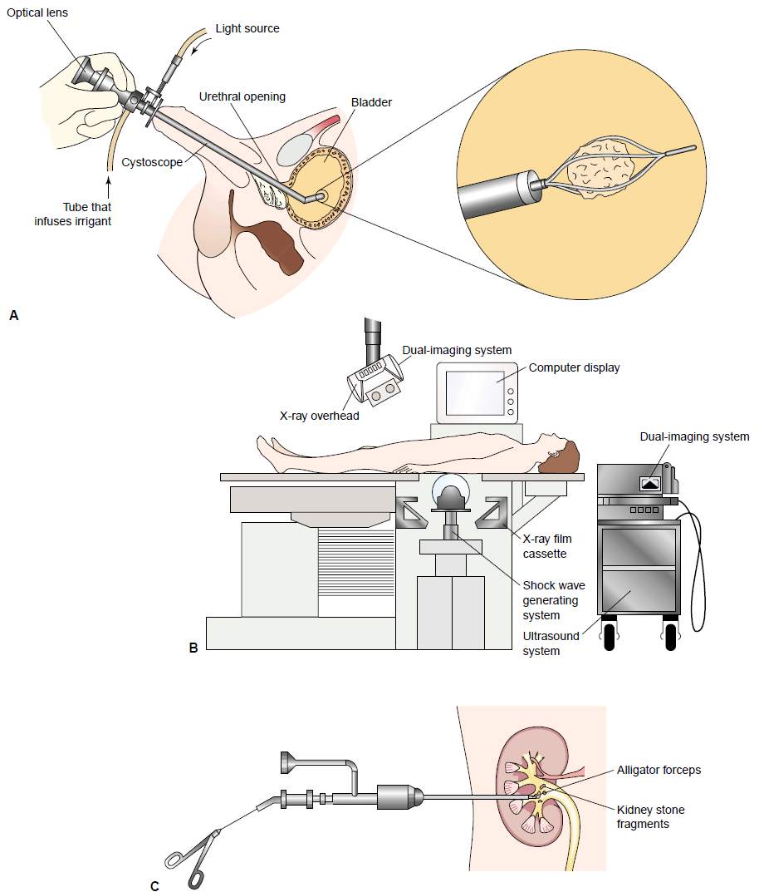
.

Slide 233
.
Provide modified diet, depending upon stone consistency: Calcium, Oxalate and Uric acid stones;
  Calcium stones: limit milk/dairy products; provide diet to acidify urine (cranberry or prune juice, meat, eggs, poultry, fish, grapes, and whole grains)
  Oxalate stones: avoid excess intake of foods/ fluids high in oxalate (tea, chocolate, rhubarb, spinach); maintain diet to alkalinize urine (milk; vegetables)

Slide 234
.
Uric acid stones :
  reduce foods high in purine (liver, beans, kidneys, venison, shellfish, meat soups, gravies, legumes); maintain alkaline urine
  Administer allopurinol (Zyloprim) as ordered, to decrease uric acid production
Cysteine stones: increase fluid intake to 4litres/24 hrs.
        low protein diet
        Alkalinisation of urine above 6.5. use sodium bicarbonate or an alkaline diet of milk, vegetables

Slide 235
.
Nursing management:
Assessment: assess for pain, discomfort & associated symptoms. Location, severity & radiation of pain.
      Observe for signs of UT I & obstruction.
      Inspect urine for blood & strain for stones of gravel.
      History focuses on predisposing factors.
Nursing diagnosis:
  Acute pain related to inflammation, obstruction & abrasion of the urinary tract.
  Deficient knowledge regarding prevention of recurrence of renal stones.
  Altered urinary elimination related to presence of caliculi.
  Potential for infection related to obstruction of the urinary tract by caliculi.

Slide 236
.
interventions:
  Analgesics to relieve pain. Opioid analgesics or NSAID’s.
  Encourage patient to assume positions of comfort.
  Prevent infection and obstruction: monitor fluid intake and output.
  Monitor voiding patterns
  Encourage increased fluid intake to prevent dehydration & increase hydrostatic pressure that aids in elimination of stones.
  Ambulation may help move the stones through the urinary tract.
  Strain the urine on a gauze to detect uric acid stones that may crumble or blood clots.
  Instruct patient to report any decrease in urine volume, bloody or cloudy urine.

Slide 237
.
  Monitor vital signs closely to detect early signs of infection because UTI may be associated with renal stones. All infection should be treated with appropriate antibiotics before efforts are made to dissolve the stone.
  Health education about causes of kidney stones, predisposing factors and recommendations to prevent reccurrence.
  Importance of high fluid intake, change of lifestyle.
  Reassurance to control anxiety.
Evaluation
  patient reports relief of pain.
  Patient has increased knowledge of healthy living.
  Patient has normal urine elimination.

Slide 238
.
URETHRAL STRICTURES
This is the narrowing of the lumen of the urethra as a result of scar tissue & contraction caused by urethral injury which can be from:
      Surgical instruments e.g. transurethral surgery
      Indwelling catheters
      Untreated urethritis, gonorrheal urethritis
      Cystoscopy
      Congenital abnormality
      Automobile accidents
CLINICAL FEATURES:
  Patient reports that force and volume of urine stream has decreased.
  Hyperdistended bladder

Slide 239
.
May have signs of infection e.g. cystitis, prostatitis, pyelonephritis.
Occurs commonly in men due to long urethra.
Diagnosis: IV urography
MANAGEMENT:
  Gradual dilation of the narrowed area using metal sounds or bougies(has a lumen). A sound is an instrument used to probe a cavity.
  If a stricture prevents catheter passage, a bougie is used to search for an opening. It is then left in place to allow urine drainage. The opening is then dilated using a larger sound.
  After dilation, a warm sitz bath and analgesics to relieve pain.
  Antibiotics are prescribed for 5 days.

Slide 240
.
In severe cases, urethroplasty is done( surgical repair of the urethra).
Sometimes suprapubic cystotomy must be performed.

Slide 241
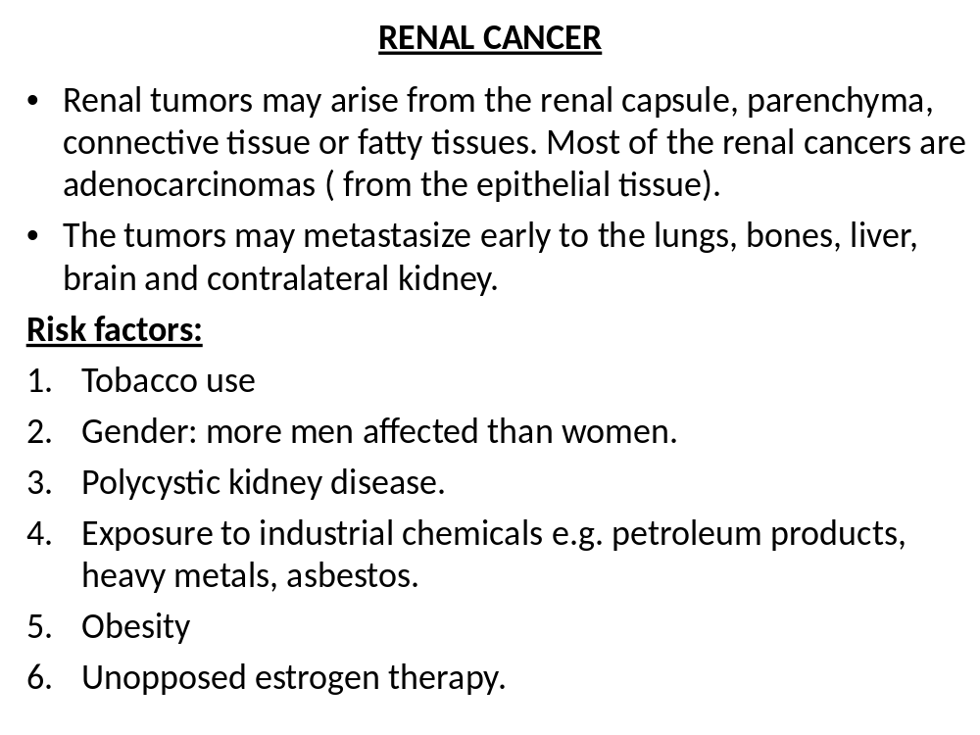

Slide 242
.
Clinical manifestations:
Classical triad of signs & symptoms:
    Hematuria- usually gross, intermittent
    Flank pain
    Palpable abdominal or flank mass
Symptoms of metastasis- unexplained weight loss, increasing weakness, anaemia.
NB: many renal tumors produce no symptoms & are discovered on routine physical exam as a palpable abdominal mass.
Diagnosis:
Intravenous urography/ IV pyelogram
Ultrasonography/ CT scan
Renal angiogram
Cystoscopic examination
Renal biopsy- done percutaneously. It provides definitive data about the lesion.

Slide 243
.
Surgical management:
Radical nephrectomy- the preferred treatment if the tumor can be removed. It includes removal of the kidney & tumor, adrenal gland, fascia fat & lymph nodes. Radiation or chemotherapy may be used along with surgery.
Partial nephrectomy- done for patients with bilateral tumors or cancer of a single functioning kidney. Its also called nephron sparing surgery. It involves removal of a part of the kidney without affecting the adrenal glands.
Renal artery embolisation- done in patients with metaplastic renal carcinoma. The renal artery or tumor vessel may be occluded to impede blood supply to the tumor & this kills the tumor cells.

Slide 244
.
Medical management:
The goal is to eradicate the tumor before metastasis occurs.
Pharmacotherapy – chemotherapeutic agents following surgical removal depending on the stage of the tumor e.g. vinblastine.
Radiation therapy as an adjunct with chemotherapy and surgery.
Nursing Management:
Give emotional support because client may be anxious about surgery, post- op renal function & possible recurrence of disease.
Post- op the patient usually has catheters and drains in place to maintain a patent urinary tract, to drain urine and to permit accurate measurement of urine output.

Slide 245
.
The patient experiences pain and muscle soreness secondary to the procedure and thus requires frequent analgesia & other coping mechanisms
Frequent assistance in turning, deep breathing & coughing are encouraged to prevent atelectasis and other pulmonary complications.
Provide family support for patient to cope with diagnosis and prognosis.
Patient education on care of incision site, activity restriction, signs of complication e.g. wound drainage, fever, hematuria, disease process & treatment plan, importance of follow up.

Slide 246
Cancer of the bladder
It is common in 50- 70 year olds and is more prevalent in men than women.
Predominant cause is cigarrete smoking
May arise from metastasis of cancer from prostate, colon rectum or lower gynaecological tract in women
Risk factors:
Cigarette smoking
Exposure to carcinogens: dyes, asbestos, rubber, leather, ink, aromatic amines
Recurrent or chronic cystitis or UTI’s.
Bladder stones.
High urinary pH.
Pelvic radiation therapy.
Cancers from prostate, colon & rectum in males.

Slide 247
.
Clinical features:
Gross (visible) painless hematuria
Infection of urinary tract producing frequency, urgency & dysuria.
Pelvic or back pain may occur with metastasis
Obstruction in voiding
Assessment:
Cystoscopy- visualize tumor directly & obtain biopsy specimen
Ultrasound- bladder & surrounding structures for metastasis
CT scan
Biopsies of the tumor
Cytological examination of the patients urine.

Slide 248
.
Management:
Depends on
-the degree of cellular differentiation
-the stage of the tumor growth(degree of local invasion)
-presence or absence of metastasis.
-The patients age, physical & mental status
Surgical management:
1. For superficial bladder cancers, the tumor is controlled by transurethral resection or cauterization… “burning”
After this, intravesical administration of Bacille Calmette Guerin(BCG), it is thought to prevent tumor recurrence and progression

Slide 249
.
2. Simple or radical cystectomy in case of invasive cancer
Radical cystectomy in men involves removal of the bladder, prostate and seminal vesicles while in women it involves removal of the bladder, lower ureter, uterus, fallopian tubes, ovaries, anterior vagina & urethra.
It may involve removal of pelvic lymph nodes.
Removal of the bladder requires urinary diversions.
Urinary diversions are means of diverting the urinary stream from the bladder so that it exits through a new route and opening in the skin(stoma).

Slide 250
.
Pharmacotherapy:
Chemotherapy with a combination of methotraxe, 5-florouracil, vinblastine, doxorubicin and cisplatin.
Topical/intravesical chemotherapy when there is high risk of recurrence or tumor resection is incomplete- BCG.
Radiation therapy-pre-op to reduce extension of the tumor. In combination with surgery or to control the disease in patients with inoperable tumors.

Slide 251
.
NEUROGENIC BLADDER
It is a dysfunction of the bladder that results from a lesion of the nervous system and leads to urinary incontinence.
Causes:
Spinal cord injury
Spinal tumor
Herniated vertebral discs
Multiple sclerosis
Congenital disorder( spinal bifida)
Infection
Pathophysiology:
Neurogenic bladder is either spastic/reflex bladder or flaccid bladder.
Spastic bladder is the more common type. It is caused by any lesion above the voiding reflex arc(upper motor neuron lesion)

Slide 252
.
It results in loss of conscious sensation and cerebral motor control. It empties on reflex, with minimal or no controlling influence to regulate its activity…even little urine elicits uncontrollable micturation reflex
Flaccid bladder is due to a lower motor neuron lesion commonly resulting from trauma. The bladder continues to fill & becomes greatly distended & overflow incontinence occurs. The bladder does not contract forcefully at any time. Sensory response is lost and the patient does not have discomfort
Diagnosis:
Measurement of fluid intake, urine output & residual volume.
Urinalysis
Assessment of sensory awareness of bladder fullness.

Slide 253
.
Management:
Use of continuous, intermittent or self catheterization.
Use of an external condom type catheter
A low calcium diet to prevent calculi
Encourage mobility and ambulation
A liberal intake of fluid to reduce urinary bacterial count, reduce stasis, decrease concentration of calcium in urine and minimize the precipitation of urinary crystals & stones.
A bladder retraining program for spastic bladder or urine retention. Voiding schedule should be established.
Double void- after voiding patient should wait 1-2 min and attempt to void again so as to empty bladder.

Slide 254
.
Parasympathomimetic drugs e.g. bethanecol may help increase the contraction of the detrusor muscle.
Surgery may be done to correct bladder neck contractures.

Slide 255
.
URINARY INCONTINENCE
It is a condition in which there is involuntary voiding of urine that becomes a social or hygiene problem.
It is a symptom of many possible disorders.
The external sphincter contracts creating positive pressure that ensures urine does not flow out.
Types of incontinence:
Stress incontinence: it is the involuntary loss of urine through an intact urethra as a result of increased abdominal pressure eg. Coughing, sneezing, laughing, lifting an objects

Slide 256
.
Urge incontinence: it’s the involuntary loss of urine associated with a strong urge to void that cannot be suppressed.
Reflex/spastic incontinence: involuntary loss of urine due to hyper reflexia in the absence of normal sensations usually associated with voiding.
Overflow incontinence: the involuntary loss of urine associated with overdistension of the bladder. Eg flaccid bladder

Slide 257
.
Functional incontinence: refers to those instances in which lower urinary tract function is intact but other factors e.g. cognitive impairment( Alzheimers dementia) make it difficult for the patient to identify the need to void.
Iatrogenic incontinence: involuntary loss of urine due to extrinsic medical factors mostly medication e.g. use of alpha adrenergic agents for hypertension causes relaxation of the bladder neck.
Mixed incontinence: a combination of stress and urge incontinence.
Risk factors for incontinence:
pregnancy, vaginal delivery, episiotomy.
Menopause
Genitourinary surgery
Pelvic muscle weakness

Slide 258
.
Spinal cord injury
DM
Stroke
Age related changes in the urinary tract
Cognitive disturbances: dementia, parkinsons disease
Medication: opiods, sedatives, diuretics, hypnotics.
Causes
Temporary: inflammation, medication, stress
Persistent/permanent: due to neurovascular dysfunction e.g. spinal cord injury, stroke.
Anatomical – due to weak abdominal & perineal muscle tone due to obesity or sedentary lifestyle.

Slide 259
.
Sphincter weakness – damage from trauma, congenital condition, urethral deformity due to recurrent UTI’s.
Psychosocial factors – anxiety, dependence, attention seeking behavior.
Fistula.. Eg VVF, ureteral vagino fistula
Management:
Depends on the type of incontinence and its causes.
Behavioral therapy-
pelvic floor muscle exercises (Kegel exercises)
timed voiding, prompted voiding
Pharmacological therapy:
Anti cholinergic agents inhibit bladder contraction and are considered first line.Eg Atropine, Scopolamine
Tricyclic antidepressants e.g. amitryptilline to reduce bladder contractions and increase bladder neck resistance.

Slide 260
.
Surgical management:
is indicated if the above methods fail.
Lifting and stabilising the bladder or urethra to restore normal urethrovesicle angle.
Use of artificial urinary sphincters.
Correct fistula
Nursing management:
Is determined by the type of treatment.
Support, encouragement for behaviour therapy as results are not instant.
Teach how to do exercises & frequency, stop smoking, regular voiding, avoiding constipation, avoiding bladder irritants e.g. caffeine, alcohol.
Explain the medication and expected outcome post operatively.
Encourage/ Maintain perineum hygiene

Slide 261
.
MALE REPRODUCTIVE SYSTEM DISORDER
Assessment
Inspect the scrotum & penis for colour, texture, shape and size
Inspect the glans for lesions e.g. ulcers, scars, nodules or signs of inflammation
Note the location of urethra (hypospadias, epispadias) & check for discharge
Inspect the contour of the scrotum, skin colour (darker than the rest of the body & has folds)
Palpate the penis to note any tenderness or redness or any mass.
Palpate the testes between the thumb, forefinger & middle finger. Check for shape, consistency(smooth, nodular, tender). Teach testicular self examination. Inspect inguinal region for any bulges(suggest hernia).

Slide 262
.
To examine the prostate, do a digital rectal examination (DRE). Located anteriorly to the anterior wall of the rectum. Check for its size, shape, consistency & tenderness. Normal size is 4 cm in diameter.
History:
History of mumps – associated with sterility. Presence of cryptorchidism at birth and age when corrected/descended.
History of major illness – diabetes, hypertension, CVA & MI – lead to impotence. MI may lead to avoidance of sexual intercourse for fear of another episode
Medication history – some hypertension drugs e.g. methyldopa, clonidine may cause impotence.
Sexual history

Slide 263
.
Diagnostic evaluation:
BLOOD STUDIES
Prostate specific antigen(PSA)
It is produced by the prostate and aids in liquefaction of semen.
Levels are increased in prostate cancer, BPH, TURP, urinary tract infection and prostatitis
Measured in nanograms/ml (ng/ml). Normal is 0.2 – 4 ng/ml.
Alkaline phosphatase
Used in men with prostate cancer. A measure of possible bone metastasis.
SEMEN EXAMINATION
One to three samples of semen are collected at intervals of 2-4 weeks.(abstains from ejaculation for 3-5 days prior test)

Slide 264
.
Tested for sperm count, morphology, motility, semen pH, viscosity, appearance and volume.(1-5mls, 60% motile, viscous liquid, yellowish white).
SECRETION ANALYSIS
Secretions from the penis, throat, anus or lesions are examined for micro-organisms.
RADIOGRAPHY
Transrectal ultrasound (TRUS) for patients with abnormalities detected or elevated PSA.
Prostatic biopsy for cytological examination. Use transurethral, transrectal or perineal approach.

Slide 265
.
INFECTIONS OF THE MALE REPRODUCTIVE TRACT
PROSTATITIS
It is an inflammation of the prostate gland.
Causes:
Escherichia coli…most common cause
Kleibsiella
Enterobacter
Chlamydia
Gonococci
Bacteria are carried through the urethra
Other causes ..urethral strictures and prostatic hyperplasia
It is classified as bacterial or abacterial

Slide 266
.
Routes of infection include urethral ascent, descent from kidneys or urinary bladder, lymphatogenous, spread from the rectum & hematogenous spread.
Clinical manifestations:
perineal discomfort
Dysuria, nocturia, urgency, frequency and pain with or after ejaculation
Prostatodynia – pain in the prostate..evidenced by pain while voiding
Acute bacterial prostatitis -fever, chills, perineal, rectal or low back pain.
Investigations:
Culture of prostate fluid or tissue histology
Dividing urinary specimen for segmental urine culture. After cleaning the glans penis the patient voids 10 – 15mls of urine into a container(represents urethral urine) without interrupting the urinary stream he collects bladder urine in another container.

Slide 267
.
If there is no acute prostatitits the physician performs a prostatic massage and collects any prostate fluid that is expressed into the third container
Culture is done on the specimen. If prostatic fluid and post massage specimen have a higher bacterial count, prostatitis is present
Management:
The goal is to avoid complications of abscess formation and septicemia.
Broad spectrum antibiotics to which the causative agent is sensitive are administered for 10 -14 days EG cipropfloxacin
Bed rest
Analgesics for pain relief
Antispasmodics to relieve bladder irritability..eg scopolamine
Sitz baths to relieve pain & spasms
Stool softeners to prevent patient from straining

Slide 268
.
Chronic prostatitis may be difficult to treat thus needs continued antibiotics including trimethoprim-sulphamethoxazole or a flouroquinolone.
Other treatment modalities for chronic prostatitis include antispasmodics and evaluation of sexual partners to reduce the possibility of cross infection.
Management of non-bacterial prostatitis is directed towards relief of symptoms
Nursing management:
promote comfort – sitz baths, analgesics, antibiotics
Health education on drug compliance, treatment regimen, avoidance of foods that cause diuresis or increase prostatic secretions e.g. coffee, tea, alcohol, spices.

Slide 269
.
EPIDIDYMITIS
It is an infection of the epididymis which usually spreads from an infected prostate or urinary tract.
Causes:
Escherichia coli
Chlamydia trachomatis (common in men below 35 years)
Gonorrhea (complication)
clinical manifestations:
Unilateral pain & soreness in the inguinal canal
Extreme Pain and swelling in the scrotum and groin
Pyuria
Bacteriuria
Fever & chills
Nausea
Frequency, urgency or dysuria

Slide 270
.
Lab. Diagnosis:
Urinalysis
Complete blood cell count
Gram stain of urethral drainage or culture
Test for syphilis & HIV in sexually active patients.
Management:
Analgesics for pain
Bed rest
Scrotal elevation to prevent traction on the spermatic cord, to promote venous drainage and relieve pain.
Antimicrobial agents, if sexually transmitted organism, treat the sexual partner also.
Intermittent cold compress to the scrotum to ease pain, later local heat or sitz baths may help resolve the inflammation.
Instruct the patient to avoid straining, lifting & sexual function until infection is under control.

Slide 271
.
ORCHITIS
It is an inflammation of the testes(testicular congestion) caused by bacterial, viral, spirochetal , parasitic, traumatic, chemical or unknown factors.
Causes:
Neisseria gonorrhea
Chlamydia trachomatis
Escherichia coli
Streptococcus sp.
Kleibsiella
Pseudomonas auroginosa
Staphylococcus sp.
A common cause of isolated orchitis is mumps.

Slide 272
.
Clinical manifestations:
Acute onset of scrotal pain & edema
Fever
Signs similar to epididymitis but in addition a hydrocele is present ( collection of lymphatic fluid in the scrotum)
Orchitis secondary to mumps occurs 4-6 days after parotitis
Management:
Antimicrobial specific to causative organism
Rest
Scrotal elevation
Ice packs/ cold compress to reduce scrotal edema
Analgesics and anti inflammatory meds
Notes:
CHIRA M.W

Slide 273
.
TUMORS OF THE MALE REPRODUCTIVE SYSTEM:
BENIGN PROSTATIC HYPERPLASIA(BPH)
It is the enlargement of the prostate gland with obstruction of urine flow
It occurs mainly in men above 50 years. 80% of men 80 years and older have BPH
Pathophysiology:
the cause of BPH is uncertain but studies suggest that estradiol(active metabolic product of testosterone) levels may have a relationship to prostate size among men with testosterone levels above median
The hypertrophied lobes of the prostate compress the prostatic urethra or bladder neck causing retention
The retained urine increases the hydrostatic pressure against the bladder wall, the bladder wall contracts forcefully to push urine past the obstruction, this results in thickening of the detrusor muscle & formation of fibrous tissue in the bladder.
Notes:
CHIRA M.W

Slide 274
.
When the bladder can no longer compensate, urine retention occurs causing backflow to the ureters & kidney leading to hydroureter & hydronephrosis.
Stasis of urine leads to infection, the internal urethral sphincter loses is muscle tone, allowing urine to dribble constantly.
Risk factors:
Smoking
Heavy alcohol consumption
Hypertension
Diabetes mellitus
Clinical manifestations
Frequency
Nocturia
Urgency
Hesitancy in starting urine

Slide 275
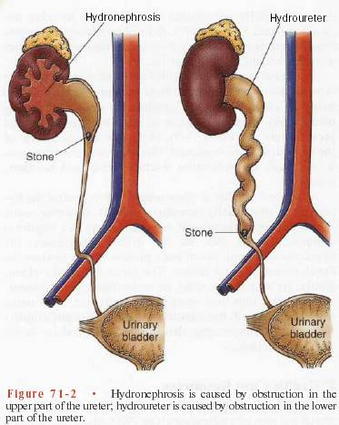
.

Slide 276
.
Abdominal straining with urination
A decrease in the volume and force of the urinary stream.
Interruption of the urinary stream
Dribbling – urine dribbles out after urination
A sensation that the bladder has not been completely emptied
Acute urinary retention( greater than 60mls of urine remaining in the bladder)
Recurrent UTI’s
Azotemia & renal failure occurs with chronic urinary retention & large residual volumes.
Generalised symptoms – fatigue, anorexia, nausea, vomiting, epigastric discomfort. .

Slide 277
.
Differential diagnosis:
Urethral stricture
Prostate cancer
Neurogenic bladder
Urinary bladder stones
Assessment & diagnostic findings
Digital rectal exam - reveals a large rubbery and non- tender prostate gland.
Renal function tests – serum creatinine levels to determine if there is renal impairement from prostatic back pressure.
Bladder percussion reveals a dull sound due to retention.
Medical management:
Depends on the cause & severity of obstruction.
If the patient is admitted due to inability to void, catheterise. An ordinary catheter may be too soft & pliable to advance through.
A stylet(a thin metal wire) is introduced into the catheter to

Slide 278
.
Prevent the catheter from collapsing when it encounters resistance.
If it fails, a suprapubic cystotomy is done to provide drainage.
Pharmacotherapy:
α adrenergic blockers e.g. terazosin, doxazosin to relax smooth muscle of the bladder neck & prostate. This improves urine flow and relieves symptoms.
Hormonal manipulation with anti androgen agents e.g. finasteride, prevents conversion of testosterone to dihydrotestosterone (DHT).
Decreased DHT levels lead to decreased prostate gland activity and size.
S/E of hormone use are gynecomastia, erectile dysfunction, flushing.

Slide 279
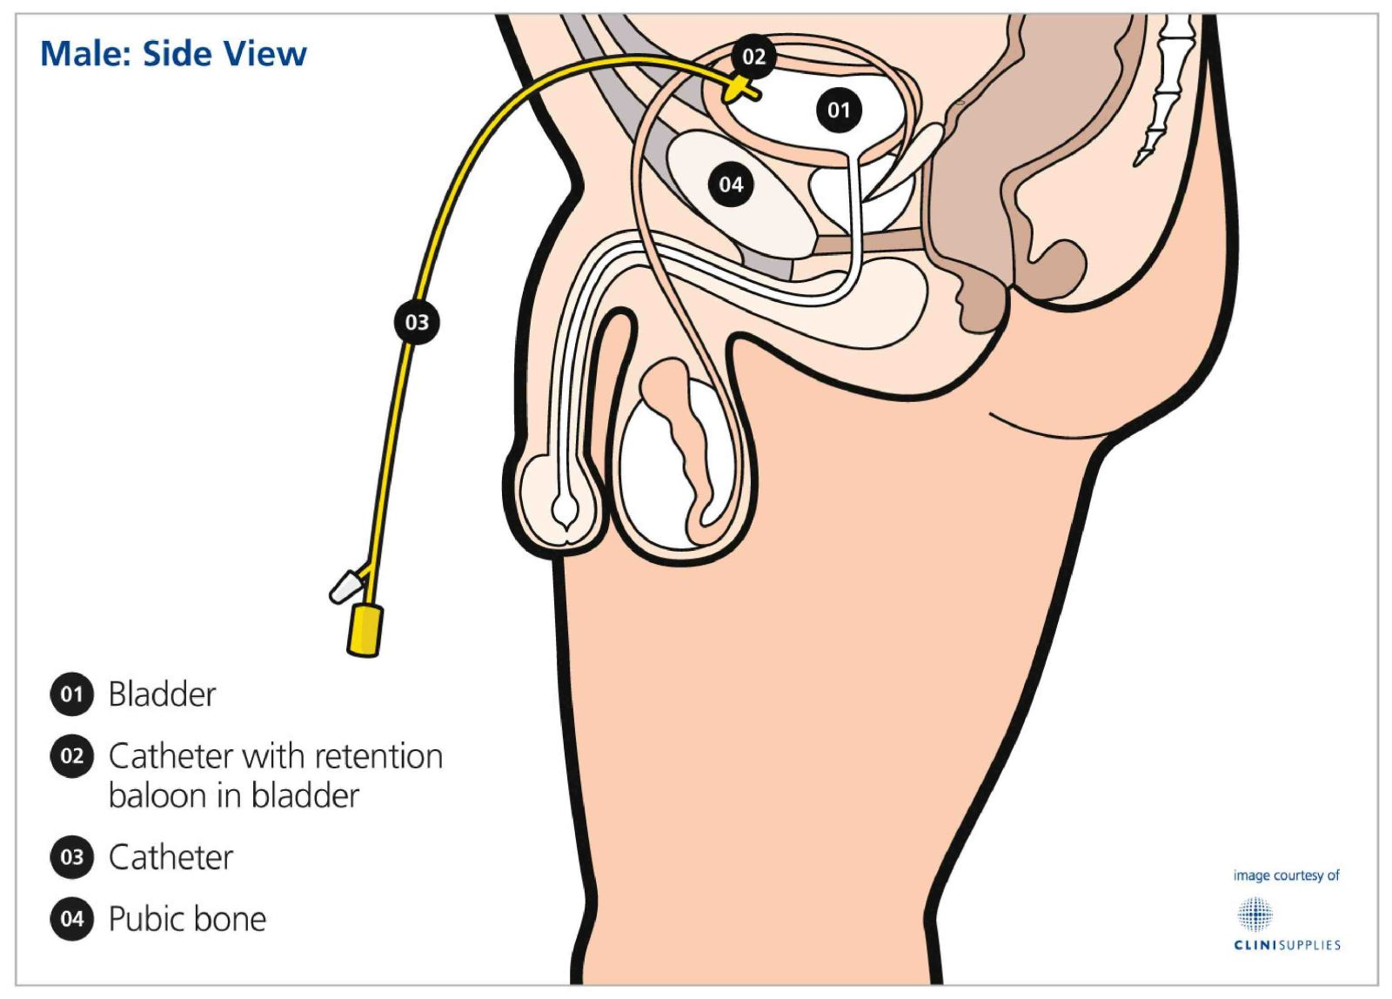
.

Slide 280
.
Surgical management:
Prostatectomy can be done through four methods:
Transurethral resection of the prostate(TURP)
Perineal prostatectomy
Suprapubic prostatectomy
Retropubic prostatectomy
1. Transurethral resection of the prostate (TURP)
It is the most common procedure used, done through endoscopy.
An optical & surgical instrument is introduced directly through the urethra to the prostate, which can then be viewed directly.
The gland is removed in small chips with an electrical cutting loop.
The tissues are flushed away using normal saline irrigation. A triple lumen catheter is inserted for this purpose. It also prevent clot formation and allow free flow of urine

Slide 281
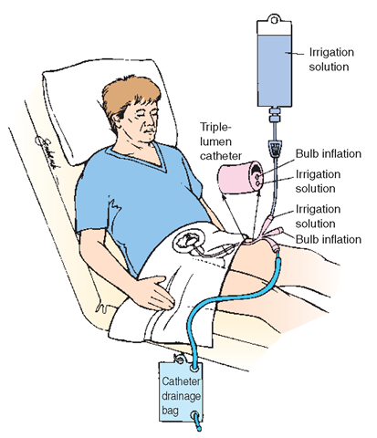
.

Slide 282
.
Complications:
Urethral strictures
Retrograde ejaculation
Risk of electric shock
Sexual dysfunction (rare)
2. Suprapubic resection:
The prostate is removed through an abdominal incision. An incision is made into the bladder & the prostate gland is removed form above.
Two catheters are inserted i.e. suprapubic & urethral catheter (for infusion & drainage).
3. Retropubic prostatectomy:
Similar to suprapubic but bladder is not opened.
This procedure is suitable for large glands located high in the pelvis.

Slide 283
.
4. Perineal prostatectomy:
Involves removal of the gland through an incision in the perineum.
It is done when other approaches are not possible.
It is useful for an open biopsy.
Post op the wound may be easily become contaminated because the incision is near the anus.
Incontinence, impotence and rectal injury are more likely with this approach.
Complications:
Post op complications depend on the type of prostatectomy performed to include:-
  Hemorrhage
  Clot formation
  Catheter obstruction.

Slide 284
.
  Sexual dysfunction – impotence due to damage to pudendal nerves
  Retrograde ejaculation

Slide 285
NURSING MANAGEMENT OF A PATIENT UNDERGOING PROSTATECTOMY:
Assessment:-
Take comprehensive history – urinary problems – decreased force, hesitancy, urgency, frequency, nocturia, dysuria, retention, hematuria.
Erectile dysfunction or changes in frequency and enjoyment of sexual activity.
Establish signs & symptoms – pain etc.
Family history of prostate cancer, BPH.

Slide 286
.
Nursing diagnosis:
Pre-op:
Acute pain related to bladder distention
Anxiety about surgery and its outcome
Knowledge deficit on factors related to disorder & treatment regimen.
Post op:
Acute pain related to surgical incision, catheter placement and bladder spasms.
Potential for complication – hemorrhage, infection, DVT, sexual dysfunction, catheter obstruction etc.
Knowledge deficit about post op care and management.
Risk for fluid volume imbalance

Slide 287
.
Pre op interventions:
Reduce patient anxiety- establish communication with the patient.
  Clarify the nature of the surgery with the expected post op outcomes.
  Provide privacy and establish a trusting professional relationship.
Relieve discomfort by bed rest and analgesics
  Monitor voiding patterns and watch bladder for distension, catheterise if necessary, if catheterization is not possible, prepare for cystotomy.
Educate the patient about procedures before and after surgery.
On the morning of the surgery, an enema is given to prevent post op straining which can induce bleeding.
Other routine pre op interventions – consent, shaving, vital signs, pre-op check list, removal of dentures etc.

Slide 288
.
Post operative interventions:
Irrigate the surgical site with a three way catheter during and after surgery to prevent clot obstructing the urinary catheter(N/S).
Monitor urine output and amount of fluid used for irrigation as fluid may be absorbed through the open surgical site and retained increasing the risk of excessive fluid retention and water intoxication.
Monitor for electrolyte imbalance(hyponatremia), increased BP, confusion, respiratory distress.
Pain due to bladder spasms manifests with urgency to void, a feeling of pressure in the bladder. Drugs that relax the smooth muscles help ease spasms e.g. oxybutinin.
  Warm compress to the pubis or sitz baths to relieve the spasms.
  Give analgesics
  Stools softeners are provided to ease bowel movement and prevent straining.

Slide 289
.
Monitor for potential complications e.g.
Hemorrhage – immediate danger because in BPH the prostate is vascularised.
  Assist in measures to stop the bleeding – suturing or trans urethral coagulation of bleeding vessels – monitor vital signs, administer medication, IV fluids, transfuse.
Infection – UTI’s, epididymitis. Use aseptic technique when dressing(depends on the approach) and give antibiotics.
DVT – use elastic compression stockings, encourage passive leg exercises..

Slide 290
.
Obstructed catheter – look out for a distended bladder. Furosemide may be given post op to promote diuresis thus keeping the catheter patent.
Continuous irrigation is used with TURP.
After catheter removal some urinary incontinence is likely but subsides over time – reassure.
Assess presence of sexual dysfunction after surgery, discuss options to restore it e.g. medication and refer to a sexual therapist.

Slide 291
.
PROSTATE CANCER
It is a malignant cancer of the prostate gland.
Risk factors:
Increasing age – greater than 50 years
Race – more common in Africans
Positive family history
Diet rich in red meat or dairy products that are high in fat.
Pathophysiology:
it is an adenocarcinoma, slow growing tumor starting from the posterior prostate and spreads to the whole gland. It spreads by direct extension to the bladder neck and seminal vesicles. It also spreads through lymphatics and hematogenous routes to lymph nodes, bone, lungs & liver.
Local growth causes urinary obstruction.

Slide 292
.
Clinical features:
Early stages rarely produce symptoms.
Difficulty & frequency of urination, retention, decrease in volume & force of urinary stream.
Blood in urine – hematuria
Blood in semen
Painful ejaculation
Signs of metastasis – back pain, perineal & rectal discomfort, anaemia, weight loss, weakness, nausea, oliguria
Assessment & diagnostic findings:
Digital Rectal Exam – reveals a nodule within the substance of the gland, extensive hardening in the posterior lobe or fixed hard nodular & enlarged prostate.

Slide 293
.
2. Prostatic surface antigen(PSA) - produced by prostatic tissue. Levels in blood are proportional to total prostatic mass and doesn’t necessarily indicate malignancy. Levels are increased in cancer.
3. Transrectal ultrasound with biopsy

Slide 294
Management
Depends on the stage of disease, patients age and symptoms.
Surgical management:
Radical prostatectomy – removal of prostate, seminal vesicles and tips of the vas deference & surrounding fat, nerves and blood vessels.
Radiation – using an external beam(teletherapy) or by internal implantation of radioactive seeds.
Hormonal therapy – based on the fact that most prostate cancers are androgen dependent and can be controlled with androgen removal.

Slide 295
.
Surgical castration (orchidectomy-removal of testes) decreases plasma testosterone thus reduce prostatic growth
Non steroidal anti androgen drugs, estrogen therapy – inhibit gonadotrophins that release androgens. S/E: gynaecomastia, impotence, decreased sperm count, risk for thromboembolism, MI, stroke.
Nursing management is similar to BPH – patient undergoing prostatectomy.

Slide 296
.
TESTICULAR CANCER
Most common cancer in men between 15 – 40 years.
Classification:
Germinal tumors – 90% of testicular cancers. Develop from sperm producing cells of the testes.
Non germinal tumors – develop in supportive and hormone producing tissues i.e. sertoli cells & leydig cells.
Secondary testicular tumors – those that have metastasized to the testicle from other organs.
Risk factors:
Undescended testes – cryptochidism
Family history of testicular cancer
Exposure to chemicals/ carcinogens
Prenatal exposure to diethylstilbesterol

Slide 297
.
Clinical features:
Mass/ lump on the testicle
Painless enlargement of the testes
Heaviness in the scrotum or inguinal region
Backache – from retroperitoneal node extension
Abdominal pain
Weight loss
General weakness may result from metastasis
Assessment & diagnosis:
Monthly testicular self examination (TSE) beginning in adolescence. Use both hands to palpate the testes. Normal testicle is smooth and uniform in consistency with the index and middle fingers under the testis and thumb on top, roll the testis gently in a horizontal plane between the thumb and fingers…

Slide 298
.
Feel for evidence of a small lump or abnormality. Palpate upward along the testes.
Locate and palpate the epididymis (a cord like structure on the top and back of the testicle that stores and transports sperm)
Repeat the examination for the other testis. It is normal to find one testis slightly larger than the other.
CT scan of the abdomen and pelvis for metastasis.
medical management:
Is highly responsive to treatment.
Testis is removed by orchidectomy through an inguinal incision. A prosthesis can be inserted.
Radiation of lymph nodes
Chemotherapy.

Slide 299
.
Nursing management:
Assess the patients physical and psychological status
Pre and post op management as any other patient undergoing surgery.
Scrotal elevation post op.
Address issues of sexuality and body image
Teach TSE.

Slide 300
.
OTHER MALE REPRODUCTIVE CONDITIONS
PHIMOSIS:
It refers to the inability to retract the distal foreskin over the glans penis
It can be congenital, as a result of inflammation, infection or local trauma.
Corrected by circumcision.
PARAPHIMOSIS:
It occurs when the foreskin of an uncircumcised male cannot be pulled back over the head of the penis
Its managed with manual reduction – where the glans is compressed to reduce its size and then its pushed back while simultaneously moving the prepuce forward.

Slide 301
.
PRIAPISM
Is prolonged, persistent penile erection without sexual desire resulting in pain.
It results from neural or vascular causes like spinal cord injury, leukemic cell infiltration, meds – alpha adrenergic blockers, anticoagulant medication injected into the penis to treat erectile dysfunction.
It is a urologic emergency because gangrene and impotence can result.
Bed rest & sedation.
Aspiration of blood from corpora cavernosa.
Surgical shunting of blood from corpora cavenosa to the venous system either saphenous vein or corpus spongiosum.

Slide 302
.
balanitis: inflammation of the glans penis, usually associated with tightness of the foreskin
Varicocele: is abnormal dilation of the veins of the pampiniform plexus in the scrotum. It is corrected surgically and the patient has scrotal support.
Hydrocele: is a collection of fluid in the tunica vaginalis of the testis. It is differentiated from a hernia by transillumination, a hydrocele transmits light while a hernia does not.
Treatment is only necessary if the hydrocele becomes tense and compromises circulation or if large and uncomfortable. It is surgically corrected.
Torsion of the testes: common in young boys and adolescents.
There is twisting of the spermatic cord resulting in cutting off of blood supply to the testis and within two hours the testis is ischaemic and if nothing is done it becomes necrotic.

Slide 303
.
It presents with sudden pain and scrotal swelling.
Urgent untwisting of spermatic cord and immobilization of the testis is done.
Cryptochidism
Undesceded testes. It is desceded to the scrotum. The prodecure is called orchidopexy
Notes:
CHIRA M.W

